Slide 1
Spring Teacher Workshop

Slide 2
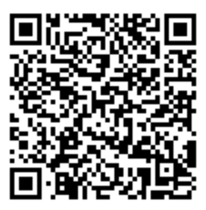
Welcome
Complete the short pre-survey:
https://redcap.link/HEPCpre2025
Sign-in with first and last name in Chat box.

Slide 3
Agenda and pacing for workshop
Welcome and Pre-Test
HSTA Reminders/Updates
Overview of Lessons 13 - 25
Work through a t-test, ANOVA, chi-square, and correlation using state data
Guest Speaker Laya talking about her Heart to Heart program
Q&A and Post-Test
Part 2 of Fidelity Project

Slide 4
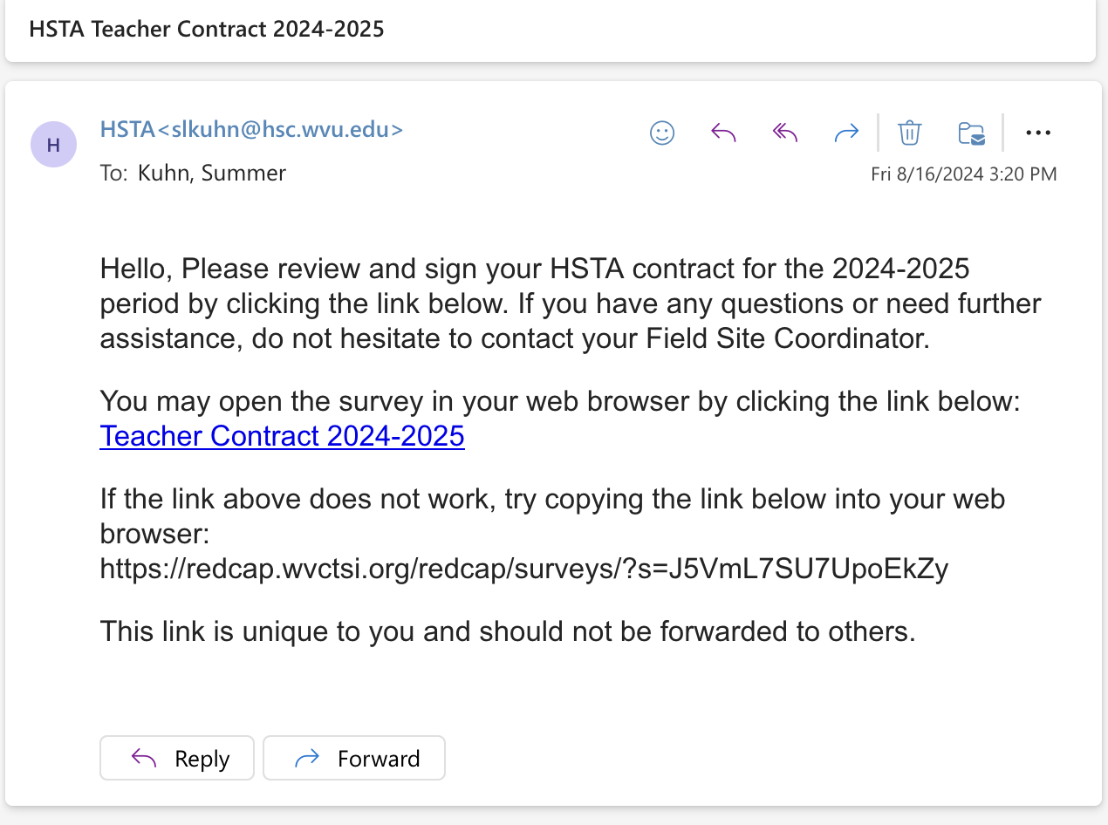
Teacher Contract
Will be sent via REDCap
- New Highlights
Spring Training $200
$50 increase on base pay per semester

Slide 5
*At minimum of 24 hours/1,440 minutes of HSTA Club time with students.
*Six hands on activities
*One Guest Speaker

Slide 6
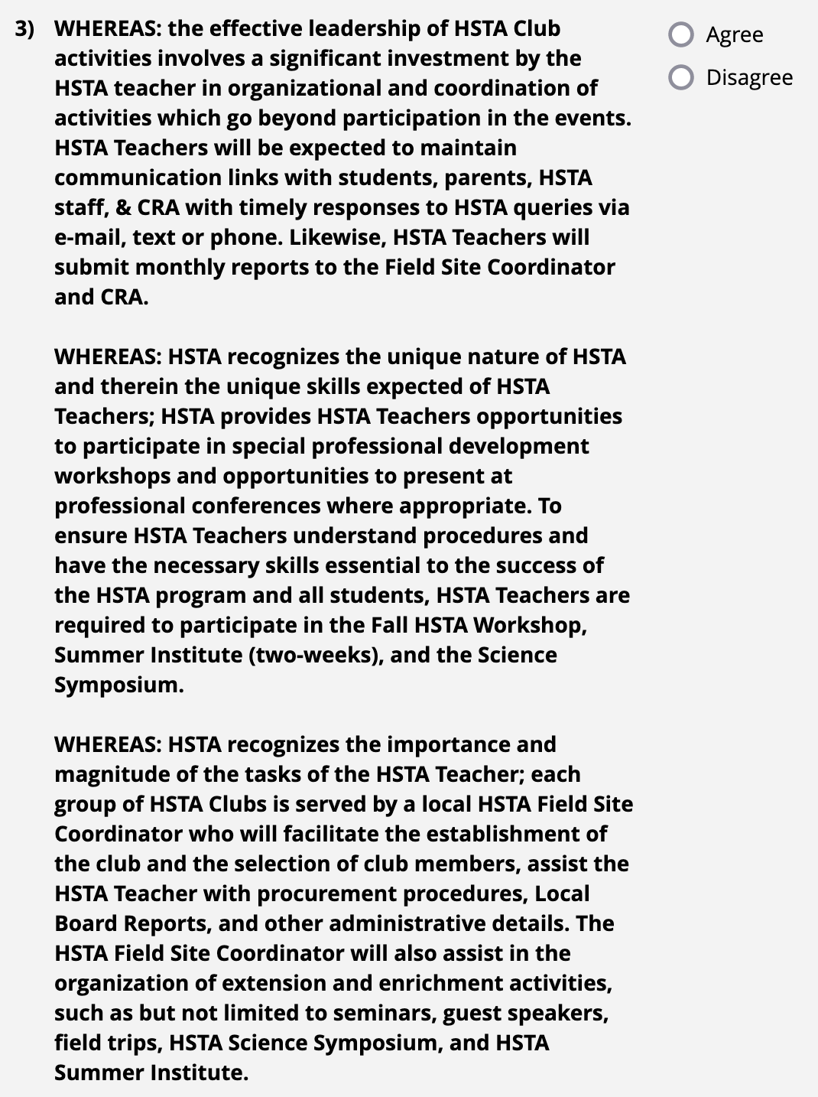

Slide 8
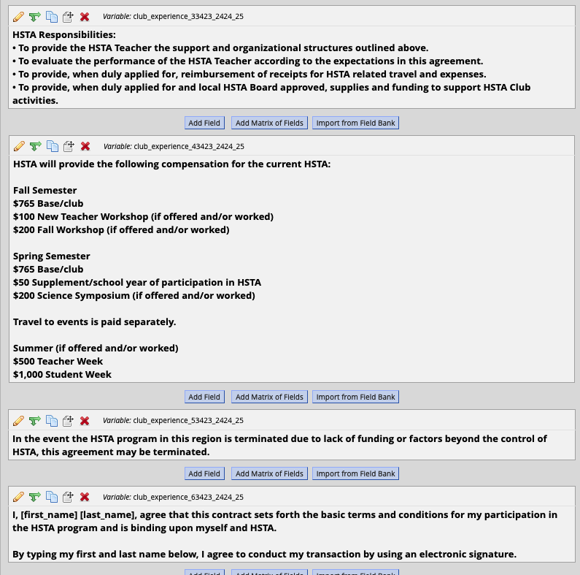
This training $200
Work Summer Camp

Slide 9
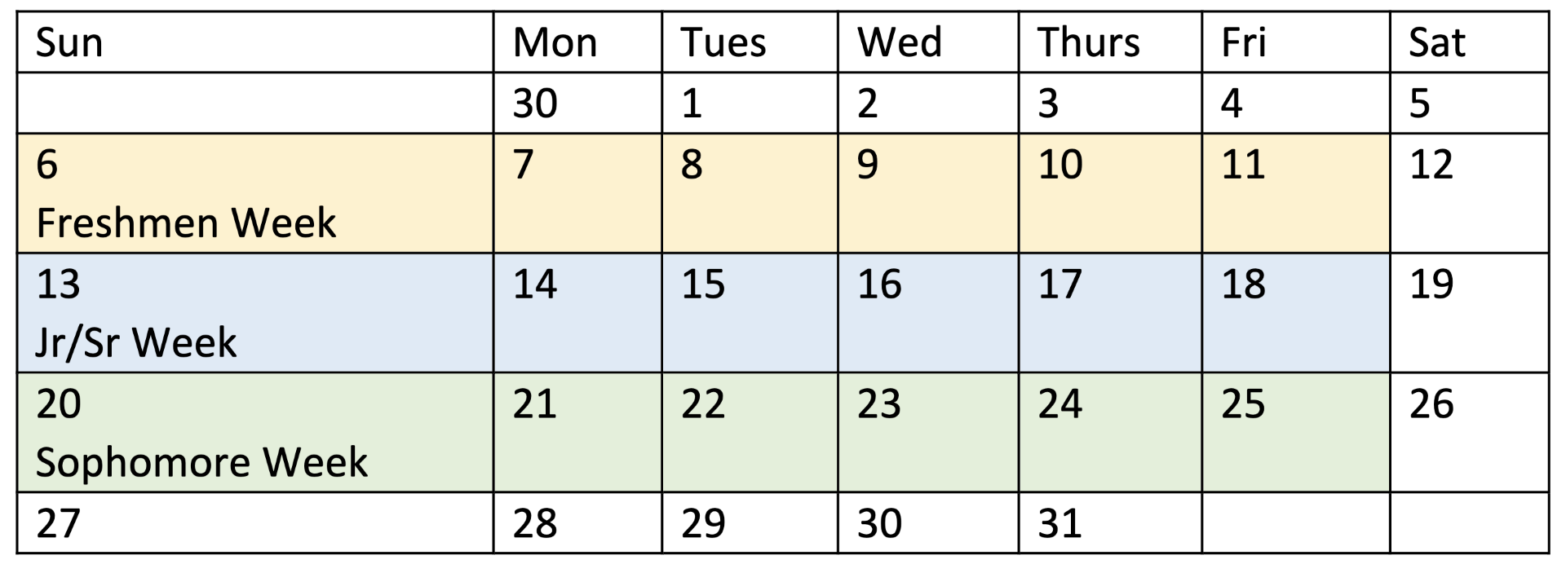
Summer Camp 2025
Teacher training dates will be released in March.
Applications will be released March 1, 2025.
Freshmen: Marshall and Potomac
Sophomore: WVU Tech and Glenville
Jr/Sr: WVU

Slide 10
HSTA and WVU Employee
We are West Virginia University Health Science Center (HSC) West Virginia State Employees.
The WVU ID is a unique nine-digit identifier used to provide students, faculty, and staff access to email and WVU systems. The WVU ID is also issued to courtesy assignments affiliated with WVU in order to gain access to certain WVU systems.
Email HSC Account https://www.hsc.wvu.edu/communication-guide/communications/email/
Currently, HSTA does not require you to use your HSC email for communication. Make sure the email you want to use is on file with your Field Site.
However, you need to make sure your HSC email account is active. This is how you get access to your WVU portal to access your pay statements, W2s, and submit travel for HSTA events. Additionally, this is how we complete trainings such as Title 9 and HIPAA and Security Awareness Training.
Passwords are good for one year.
Each year you must complete HIPAA and Security Awareness Training before your password expires. You will log into https://sole.hsc.wvu.edu with your Master ID (username and password).
If you need to find your WVU ID, reset passwords, etc. visit https://login.wvu.edu/self-service/
To access your HSC Email.
Use Google to search for Microsoft 365 Login, click on the login link, and enter your HSC Email and Password.
Strongly suggest you use a different internet browser than the one you use for your school email.
You will be asked to use the DUO App. Click on the link to read more about how to use the DUO App. https://its.hsc.wvu.edu/help-desk/two-factor-authentication/health-sciences-campus-two-factor-authentication-resources/
VPN to access W2 information and Pay Statements https://wvusharedservices.wvu.edu/s/article/Virtual-Private-Network-VPN

Slide 11
HSTA and WVU Employee
If you need to change your password, follow the directions below.
Visit https://login.wvu.edu/self-service
Click on Forgot or Change Password.
If you need your HSC information, follow the directions below.
Re Claim your WVU Account: Visit https://login.wvu.edu/self-service
Click on Look up WVUID.
It will ask for your date of birth and SSN. Click submit.
It will give you your WVUID number and Username.
Go back to the main page of https://login.wvu.edu/self-service and click on forgot or change password.
It will ask for your First and Last Name, Birthdate, and WVUID.
You will take a quiz and then be able to reset your password. If you have any issues, call WVU IT 304-293-4444.
Troubleshooting:
If this doesn’t work, visit https://login.wvu.edu/self-service click on unlock account.
Call WVU IT 304-293-4444. They will ask for your WVU ID number. Make sure to tell them you are a HSC employee.
If you know your username and password and the email will still not work, visit https://sole.hsc.wvu.edu Log in username and password. This program will allow you to take your HIPAA and Security Awareness Training.
If Microsoft doesn’t allow you to login, log out of your school account. Clear history of your browser and try again. If Microsoft doesn’t allow you to login, open a different browser then you use for you school account.

Slide 12
Working with Minors under the University Umbrella
WVU has set rules related to working with minors. HSTA is a WVU program.
Children on Campus Overview https://diversity.wvu.edu/equity-assurance/children-on-campus
We exist to make children safer while they participate in WVU programs. We also want to help WVU community members who are administering those programs to comply with relevant laws and WVU policy.
To do this, we provide training, educational resources, and coordinate efforts across the University to establish guidelines and best practices that promote the safety of youth engaged in WVU programs, activities, events and research. Our services are guided by nationally recognized best practices, federal and state laws and regulations found within West Virginia University.
Each year, thousands of children interact with WVU through a variety of programs and events both on and off campus, so West Virginia University’s leadership is committed to ensuring that youth who engage with the university are protected from harm. West Virginia University welcomes youth and their families as members of the University community with the expectation that everyone will have a safe, enriching and inclusive experience.
Mission Statement:
West Virginia University is committed to the protection of children participating in programs and activities on campus, as well as in WVU-sponsored off-campus events. In furtherance of this commitment and consistent with Board of Governors Rule 1.7, the Division of Diversity, Equity and Inclusion will:
Stay informed on developments impacting youth protection in West Virginia and nationally;
Be an active resource for WVU units planning to host programs involving Visiting Children (“Host Units”), in an effort to create a positive, safe experiential learning environment for program participants;
Partner with Host Units to ensure they develop, implement and regularly review guidelines for the supervision and safety of Visiting Children; and
Facilitate a volunteer vetting program to ensure that adults who have Direct Contact with Visiting Children have undergone required background checks and training.
Guidelines and expectations for program and event administrators.

Slide 13
HSTA Trainings through WVU
Title IX: emailed to your HSC account from complianceeducation@notify.wvu.edu
HIPAA: accessed through https://sole.hsc.wvu.edu/ with Master ID
Cybersecurity Awareness Training: emailed to your HSC account from notifications@notify.wvu.edu
Background and DMV check: will be sent via email from HIRE RIGHT
CITI: create an account with an email address, training is good for five years
If you have questions or concerns, contact the ITS Service Desk at 304-293-4444 or ITSHelp@mail.wvu.edu.

Slide 14
Teacher Travel
Click the link to access more information on how to submit travel for HSTA related events as well as videos that will walk you through the process. HSC Account and Mileage Information.

Slide 15
Teacher Evaluations
Teacher evaluations were sidelined during COVID. We are working on updating the evaluation. Spring 2025 will serve as a baseline year.
General Overview
Each FSC will send a copy of the self-evaluation to each teacher to complete.
Teachers are asked to return the completed self-evaluation to the field site prior to their evaluation meeting with the local board and to bring a copy with them.
The local board members and FSC will use the self-assessment and complete their assessment with the teacher. This is a time for discussion and planning.
Veteran teachers with more than 3 years of experience will be evaluated every three years.
Teachers with less than 3 years of experience will be evaluated yearly until such time they reach veteran status.

Slide 16
Final Symposium Deadlines
Final presentation will be submitted to REDCap by April 25, 2025 5PM.
Final presentation must be submitted to REDCap on or before April 25, 2025 5PM. REDCap will send you a link to upload your project. All students will submit their project to REDCap, i.e., if you work in a group each group member will submit to REDCap via their email.
Presentations will be pre-loaded and ready to go on the day of symposium, so it is very important you submit your final project on or before April 25, 2025 5PM.
If you fail to submit on time, you will not be able to present at the Symposium and will need to speak with your LGB.

Slide 17
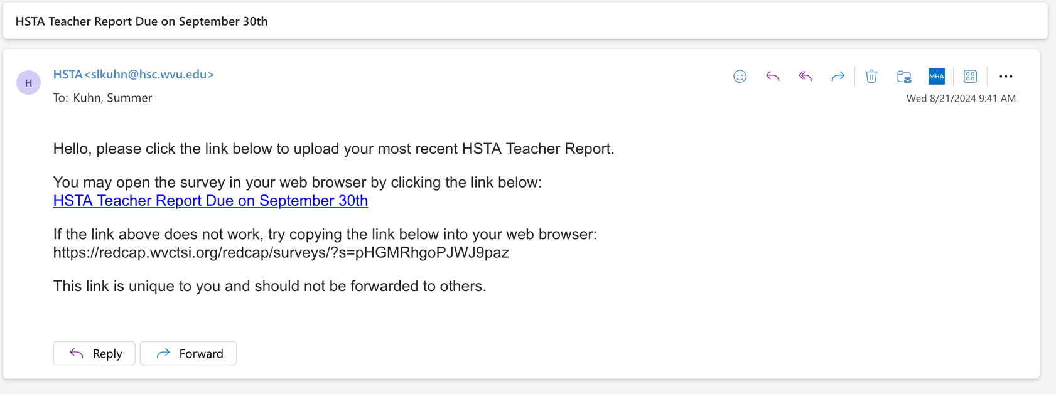
How to submit final project
Each student will get an email like the one below. It will ask them to upload their final presentation.
All students will submit a copy of their final presentation.
After they submit the final presentation, they will be asked three AHEC questions.

Slide 18
Symposium
April 26th
Southern WV: Kanawha , Greenbrier/Fayette, Raleigh/Mercer, Mingo/Logan, McDowell, Cabell/Lincoln/Boone
May 3rd
Northern WV: BWRC, Eastern Panhandle, Mountain HSTA, Ohio/Marshall, Harrison/Monongalia/Marion
- FSC and teachers will work together on transportation
- If students need be to excused, they will talk with
FSC to submit the forms for LGB and JGB review.

Slide 19
WV State – April 26th
Start at 9AM & end 1PM
Lunch starts at Noon – 4PM
McDowell
Greenbrier/Fayette
Raleigh/Mercer
Kanawha
Cabell/Lincoln/Boone
Mingo/Logan
Draft Schedule:
Opening starts at 9:00AM
Presentations from 9:30AM – Noon
Closing at Noon
Lunch to go starting at 12:20PM
Draft Schedule:
Lunch at Student Center Noon
Opening 12:45PM
Presentations from 1:15PM – 3:45PM
Closing at 3:45PM

Slide 20
WVU – May 3rd
AM 9AM – 1PM
Noon – 4PM
MT HSTA Counties TBA
Eastern Panhandle
Braxton/Webster/Roane/Calhoun
Harrison/Mon/Marion
Ohio/Marshall
MT HSTA Counties TBA
Draft Schedule:​
Opening starts at 9:00AM​
Presentations from 9:30AM – Noon​
Closing at Noon​
Lunch to go starting at 12:20PM
Draft Schedule:
Lunch at Mountain Lair Noon
Opening 12:45PM
Presentations from 1:15PM – 3:45PM
Closing at 3:45PM
Teachers with an active Master ID will help log into WVU Computers during the symposium.

Slide 21
Teacher Reports
Field Site Coordinators must use the teacher reports to complete their mandatory monthly reports. Teacher reports are also required by WVU’s Children on Campus program. Teacher reports are due on the last day of the month to accommodate this schedule. Make sure your report is up to date and submitted on the last day of the month.
You will be emailed a REDCap link at the end of the month to attach your report and answer 1-3 questions about the club. The email from REDCap will look like this one:

Slide 22
Teacher Reports
If you have co-teacher, you will still complete your report and mark that your co-teacher attached the attendance report.
All club meetings will be in person.
Teacher Report may consist of the following items:
Click here for a copy of the teacher report and download the report you need. If you can’t access the files, email your FSC for a blank copy.
You will enter student’s name and their attendance for each meeting. Meetings are based on minutes/hours. The minimum is 24 hours.
On this same sheet, provide a summary of each meeting.
If you want a confirmation email, you can enter your email address once you submit.
Due Dates:
January Report is due on January 31st
February Report is due on February 28th
March Report is due on March 31st
April Report is due on April 30th
May Report is due on May 31st

Slide 23
HSTA at a Glance – Spring Term
Spring Training for Teachers January 11, 2025
January 17, 2025 (Final day to have an approved project)
Recruitment starts January 2025 (FSC will have local deadlines)
Summer camp applications open March 1st – close March 31st
April 11, 2025, symposium excuses for students due. Speak with FSC.
April 25, 2025: Final Symposium Projects are uploaded in REDCap
April 26, 2025 Southern WV: Kanawha , Greenbrier/Fayette, Raleigh/Mercer, Mingo/Logan, McDowell, Cabell/Lincoln/Boone
May 3, 2025 Northern WV: BWRC, Eastern Panhandle, Mountain HSTA, Ohio/Marshall, Harrison/Monongalia/Marion

Slide 24
HSTA and REDCap
REDCap is the database system we use to keep records. As a teacher you do not have direct access to REDCap. If you need information from REDCap a FSC or CRA can send you a report.
To complete REDCap forms, submit reports, submit student projects for feedback, etc. there are two ways depending on the form, report, etc. Below is a summary of all the REDCap forms and submission for HSTA teachers and students.
For all teachers and students, if REDCap sends you an email with a unique link, it will look like the example below:

Slide 25
HSTA and REDCap
Below is a REDCap summary for HSTA Teachers:
An email will be sent directly to teacher with unique link
Teacher HEPC Grant Report [if you want to participate]
Teacher Monthly Reports
Teacher Summer Camp Sign Ups
Public link will be emailed out. All teachers will use the same link.
Teacher End of Year Evaluation
Teacher Summer Camp Evaluation

Slide 26
HSTA and REDCap
Below is a REDCap summary for HSTA Students: It is very important we have the most updated email address for all students.
An email will be sent directly to student with unique link
Student Contract, Photo Release, Transcript, AHEC Survey [new students/ freshmen]
Student submission of final symposium project and AHEC Survey
Student Summer Camp Sign Ups
Public link will be emailed out. All teachers will use the same link.
Student End of Year Evaluation
Student Summer Camp Evaluation

Slide 27
OnTrack: Registration
On January 13th students with existing OnTrack accounts will get one-time use login link. When the students click the link, the only fields they need to populate are creating and confirming their password, then scroll to the bottom of the page and click save.
Freshmen or students without an existing OnTrack account, will be added to the program by the Field Site.
Here is the link to the Student Walkthrough Video to help introduce ONTRACK Plus to your students. This video is very helpful!
Only your Field Site has access to the OnTrack program.

Slide 28
OnTrack: Community Service Hours
Completed videos from 8/5/2024 until 5/30/3025 can converted into community service hours.
Each video is worth 5 minutes = Total of 14.5 hours over four years.
12th 47 Videos ~ 4 Hours
11th 47 Videos ~ 4 Hours
10th 43 Videos ~ 3.5 Hours
9th 40 Videos ~ 3 Hours
Students can start their next-grade videos in the Summer!

Slide 29
Accessing the Curriculum
https://health.wvu.edu/hsta

Slide 30
Lessons
Overview of Spring Lessons

Slide 31
Break

Slide 32
Sign back in with first and last name in Chat box.

Slide 33
Non-State Projects
- Data Collection Sheets

Slide 34
State Data
https://health.wvu.edu/hsta

Slide 35
Data Analysis Tool Pak
Directions in notebook.

Slide 36
t-test

Slide 37
Lunch Break

Slide 38
Sign back in with first and last name in Chat box.

Slide 39
Layla

Slide 40
ANOVA

Slide 41
Correlation

Slide 42
Chi Square

Slide 43
Final Approval
No data can be collected until CRA gives 40 Points and the stamp of Approval.
Deadline 4 reminder on January 13th. Talk with CRA if club will be late on submissions.

Slide 44
HSTA Data Usage
IRB-protected HSTA Projects (State Survey and TEAMS Intervention) are not allowed to be presented outside of HSTA unless approved by CRA. This data is protected and we must update the IRB of the data use.
Projects with an intervention, survey, and/or experiments with human are not IRB-protected and should not be shared outside of HSTA. These are classroom projects without an IRB and are used to learn about research.
Experiments with non-human invertebrates are fine to share outside of HSTA once the project is approved and completed.

Slide 45
Wrap Up
Q&A

Slide 46
Thank you!
Complete the short post-survey:
https://redcap.link/HEPCpost25
Sign-out with first and last name in Chat box.

Slide 47
HEPC Grant – One time Grant
Fall Training: Lessons 1-12
Fidelity Project - Earn $400 paid with Spring Training
Spring: Lessons 13-25
Fidelity Project - Earn $400

Slide 48
Fidelity Project Earn $400 Spring Term
Tasks:
Give report on all objectives
Report Pros/Cons, Changes, Suggestions
Photo Report
Turn in monthly

