Slide 1
Lesson 4: Project Selection and Observation
Summary: Students will select their research project topic and complete their observation slide.

Slide 2
Objectives:
Introduce 9th and 10th Grade Students to the HSTA Statewide Survey
  Discuss how to recruit participants for the HSTA statewide survey
  Identify the procedures for conducting research using the HSTA statewide survey
  Complete and share the HSTA statewide survey
  Review the variables included on the HSTA statewide survey
  Identify a research question that can be answered using the HSTA statewide survey
Introduce 11th and 12th-grade students to Menu, Self-Selected, and/or working with 9th/10th grader
  Discuss strategies for selecting a research topic
Complete Observation PowerPoint Slide
  Download the HSTA Presentation PowerPoint template
  Complete the Observation slide using the information

Slide 3
Important Notes About the Statewide Survey: Students will use the survey to select two questions they are interested in as they follow the exercise below. Then they will continue to build their Research PowerPoint through other lessons. Students will be asking family, friends, and peers to complete the survey. Once students have completed their CITI training, earned 40 points on their Research PowerPoint, and shared the survey, they will get access to the data. Teachers will have a spring workshop to discuss lessons 13 – 25. These lessons will walk students through analyzing data and completing their Research PowerPoint.
Everyone is required to share the survey link and assist in data collection.
County-specific data will be posted if at least 50 surveys are fully collected from that county. When data starts to be collected, we will share how many surveys have been collected by county.
Data will be accessible with a password.
Each categorical survey question will be limited to 5-7 response options.
There are sections in the survey that you must be 18 years of age to complete.
  The survey will control which questions they see based on age.
  Students can have data for all questions

Slide 4
State Survey Participant Recruitment
We are going to talk about recruiting for the Statewide Survey human subject research project. All 9th and 10th graders are working with the WV State Survey. Students will collect data from their families, friends, schools, communities, neighbors, social media networks, etc.
When recruiting participants for a research study, remember the three main ethical principles: Respect, Beneficence, and Justice.
Respect: When recruiting subjects to participate in your study, 1) first explain what the survey is about [topic], 2) why you are conducting it, [for a research project for HSTA to learn about_____], 3) how you are going to protect their autonomy they can chose to not participate or may cease to participate if they become uncomfortable, and 4) how you will protect their anonymity [no names or identifiers will be used].

Slide 5
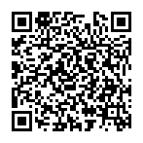
Beneficence (Do Good/Not Harm): When recruiting subjects to participate in your study, explain how your research may benefit them and/or others by increasing or improving the knowledge about what you are testing.
https://redcap.link/state2526

Slide 6
Justice: When recruiting subjects to participate in your study, make sure that you treat everyone equally. This means being fair.
Recruitment Goals: Students working on the state survey need to ask 20 individuals from their community or as a club, ask three classes in their school to complete the survey. If you have research questions about teens, asking classes to complete the survey is a great way to collect information. If you have research questions about adults, asking community members to complete the survey is a great way to collect information. Think about your population.

Slide 7
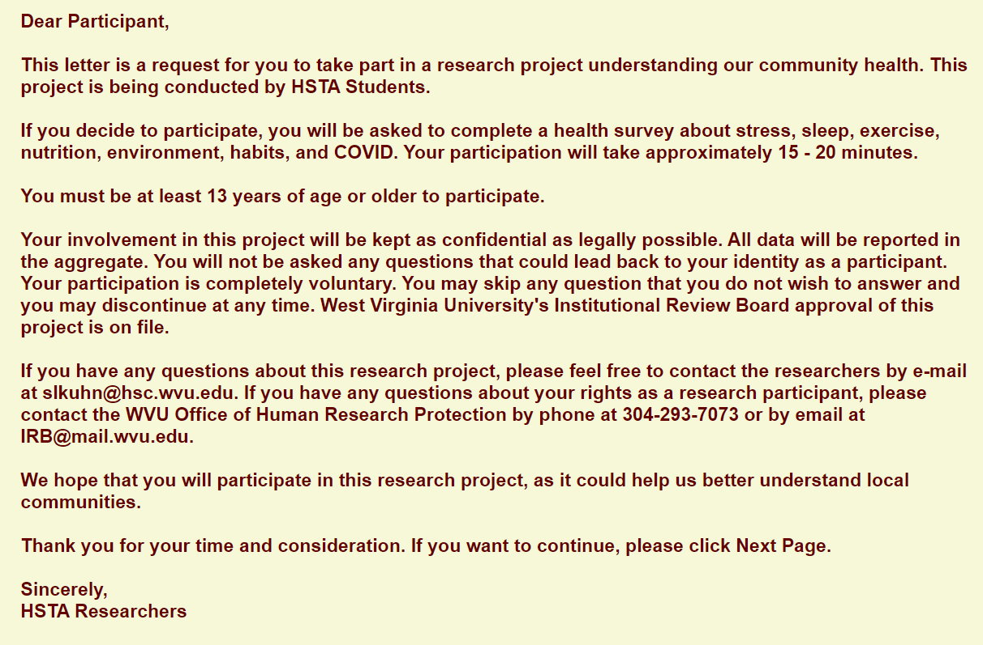
Cover Letter for State Survey
https://redcap.link/state2526

Slide 8
After students take the state survey, have 11th and 12th graders read over the Research Menu https://health.wvu.edu/hsta/resources/teachers/research-projects/research-menu/ or brainstorm other ideas. Have 11th and 12th graders read over Project Selection for Students in the 11th and 12th grades. If they are working with a 9th or 10th grader, they will do the next part with the younger students.
While 11th and 12th graders are reading about project ideas, walk the other students through the state survey procedures.

Slide 9
HSTA State Survey – Observation
All 9th and 10th grade students, will use the HSTA Statewide Survey to conduct a cross-sectional/prevalence study. This type of study examines a population at a specific point in time. For example, if you measure the attitudes of 9th graders at your school in September, their attitudes might change by May.
The HSTA State Survey has pre-developed questions students will use in their research project. HSTA student researchers will share the State Survey with family and friends between September 2025 and January 2026. Then students will use the data collected through the State Survey to complete a HSTA research project.
Choosing a research topic can be challenging, and by starting with a State Survey, students will gain a solid foundation in research methodologies before selecting they select their own topics during their junior and senior year of high school. Furthermore, using the HSTA State Survey, allows student researchers to develop essential research skills, such as formulating a research question, selecting variables, writing a hypothesis, designing procedures, and applying statistics to answer questions and draw conclusions before diving into their own research ideas during their junior and senior year of high school.
Students can start sharing the survey with family and friends. They may want to read over the general procedures of the project to get an idea how the project will follow. During later lessons, students will review procedures.

Slide 10
HSTA State Survey – Procedures
Completed CITI training to learn about research ethics as a freshman in high school.
Used the HSTA State Survey 2025-2026 to collect community data on the insert the topic.
Selected variables that we were interested in and asked a research question.
Worked on background research and other presentation elements during our HSTA Club.
Shared the survey link from September 2025 – January 2026 with family, friends, and community members.
  Participants read a cover letter before they started the survey to learn about what types of questions were asked.
Once the survey was closed, HSTA CRAs posted a password-protected raw data file for download.
Learned about statistics and graphing through HSTA club lessons.
Completed descriptive statistics and graphing to display data to describe the data set.
Completed insert statistical test name here to see if our data supported or rejected our null hypothesis.
Drew conclusions.
Now that students are familiar with the project, they need to select two survey questions they want to study. These two survey questions will drive their research question, variables, and hypothesis. Today, they will use these two survey questions to write a research observation.

Slide 11
As students work through the survey, their goal is to pick two survey questions they want to compare against each other. Students can use the following guide questions to help them connect survey questions.
  Is there a difference among Survey Question A and Survey Question B?
  Is there a relationship among Survey Question A and Survey Question B?
Note: As a 10th grader, your project must be distinct from last year’s. Avoid using projects from previous students.

Slide 12
The Statewide Survey has many questions. When students read over the survey questions, tell them to think about problems they see in their community. For instance, there is a survey question about BMI. Based on online information, 70.9% of WV residents are overweight or obese (WV Department of Health, 2024). This is a community problem.
Take another survey question that asks how many days did you feel your mental health was not good? Based on information from United Health Foundation (2024), 21.1% of WV adults said their mental health was poor 14 + days in the past month. These same online resources state that WV is ranked 50th for mental distress. This is a community problem.
Tell students to take time and look over the other survey questions and do a short internet search. What does the internet say about BMI and WV, mental health and WV, nutrition and WV, vaccines and WV, etc.? Students will want to save the websites they visit for when they do background research.
Have students select one survey question they find the most interesting.
Write down the survey question (survey question # 1):
______________________________________________________________________________

Slide 13
Now students need a second survey question to help them build a research project. Students should take their first survey question and ask
do I want to see if there is a difference among survey question #1 and blank?
do I want to see if there is a relationship among survey question #1 and blank?
blank can be several things such as: gender, county, stress levels, eating breakfast, access to grocery store, etc.
Students may want to pick a few survey questions and do a short internet search.
What does the internet say about survey question #1 and blank? Students will want to save the websites they visit for when they do background research.
Have students select one survey question they find the most interesting.
Write down the survey question (survey question # 2):
_____________________________________________________________________________

Slide 14
Now that students have two survey questions, have them look at their internet searches and complete the observation statements:
The project problem is ____.
This project is important to the community and me because ____.
The project summary is ____.
The project type is prevalence/cross-sectional.
Before students leave the club meeting, they should download the Presentation PowerPoint and complete their observation slide. They need to save it in a location they can easily access next meeting. If they have group members, they need to make sure all members have access to the file.

Slide 15
Project Selection for Students in the 11th and 12th Grades
All 11th and 12th graders can create with own idea with approval, work from the Research Menu https://health.wvu.edu/hsta/resources/teachers/research-projects/research-menu/ or work with 9th/10th Grader(s) on State Survey.
Ask 11th and 12th graders what research topics they are interested in? If they are struggling with ideas, 1) think about the project from Summer Camp, 2) visit the research menu, and/or 3) look over their research project from last year and see how they can grow or improve the project.
Note: You may build upon or enhance your project from last year, but you cannot reuse the same project. Avoid using projects that were completed by other students in the past.
Once they have selected a research topic, they will begin working on their observation slide.
The project score sheet gives the observation slide three points.
  Observation states the project’s problem clearly.
  Observation includes why this project is important to the community and me.
  Observation includes a short summary of the project, including project type: prevalence, intervention, human experiment, or non-human experiment.

Slide 16
Before students leave the club meeting, they should download the Presentation PowerPoint and complete their observation slide. They need to save it in a location they can easily access next meeting. If they have group members, they need to make sure all members have access to the file

