Slide 1
Lesson #18: Graphing Data
Summary: Students will learn how to graph data.

Slide 2
Objectives
Demonstrate how to graph data.
Graph data for HSTA research project.
Complete HOA #10.
If 11th or 12th graders do not have data to graph, have them continue to work on their project. If they are waiting on materials, data collection, etc. they can be paired up with a younger group and help them graph HSTA state data.

Slide 3
HOA 10 – Graphing
HOA 10 – Graphing
For this HOA, have students do a lab that allows them to practice graphing.

Slide 4
Underclassmen (9th and 10th graders; 11th and 12th graders partners) make sure your Measures of dispersion (Range, Standard Deviation, and Variance) are complete before students move onto graphing.

Slide 5
How to Graph Data
The best advice that a statistician can give a young researcher is to always graph data. The visual presentation of the data will give a better understanding of the relationships between variables and/or groups compared to a data table. The type of graph that one will use to display data is controlled by the type of variables that are used in the research study. Have students read over the chart below to discover what type of graph they should complete based on their research variables.
Independent Variable or Variable One is ____ and it is qualitative or quantitative. (Circle One)
Dependent Variable or Variable Two is ____ and it is qualitative or quantitative. (Circle One)

Slide 6
 | Dependent Variable or Variable Two is qualitative | Dependent Variable or Variable Two is quantitative
Independent Variable or Variable One is qualitative | Data should be displayed using a pie chart. Students will evaluate the relationship with a chi-square. | Data should be displayed using a bar graph. Students will evaluate the difference with a t-test (two groups) or ANOVA (three or more groups).
Independent Variable or Variable One is quantitative |  | Data should be displayed using a scatterplot or line graph. Students will evaluate the relationship with a correlation.

Slide 7
Continue reading the next few pages and find the directions for completing each graph. NOTE: This is in no way a comprehensive list of charts and graphs. There are others that may be used to describe statistics. Make sure to tell students it is important they select the one that is appropriate for their data set(s).

Slide 8
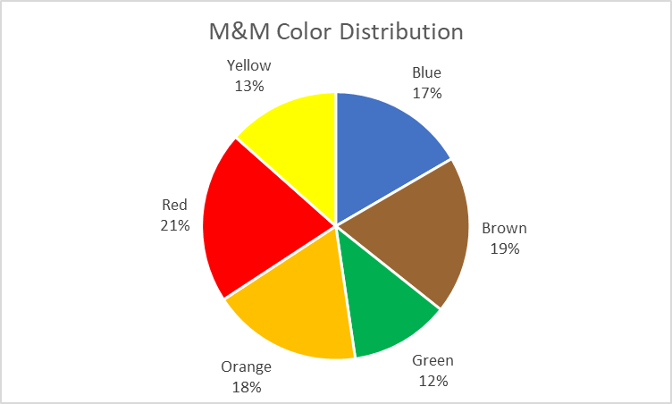
Pie Chart
Pie charts are best suited when the researcher wishes to graphically represent percentage data for qualitative variables (variables whose measurements contain text as opposed to numbers). Commonly used nominal or categorical variables in HSTA projects include gender (male/female), high school class level (freshman/sophomore/junior/senior), and whether or not a research participant meets a given study inclusion criteria (yes/no).
Important characteristics of a pie chart that should always be present include: 1) a name for the pie chart that clearly describes the data being represented, 2) a key/legend identifying the nominal or categorical variable each slice of the pie represents (if you are not individually labeling your pie slices), and the valuation (percentage) that each slice of the pie represents. Note: When using a pie chart, the sum of all of the percentages must equal 100%.
Watch this video to learn How to Make a Pie Chart in Excel.

Slide 9
Bar Graph
Bar graphs are best suited when the researcher wishes to graphically represent count data or data representing the mean of a dataset for qualitative variables (variables whose measurements contain text as opposed to numbers). Commonly used nominal or categorical variables in HSTA projects include gender (male/female), high school class level (freshman/sophomore/junior/senior), whether or not a research participant meets a given study inclusion criteria (yes/no), and counties of residence (Monongalia/Kanawha/McDowell/Berkeley).
Important characteristics of a bar graph that should always be present include: 1) a name for the bar graph that clearly describes the data being represented, 2) a label for the x-axis (indicating the independent variable values), 3) a label for the y-axis (indicating the values possible for the dependent variable, in this case, counts), and 4) a key/legend if the independent variable contains sub-groups (i.e. diabetic males, diabetic females, non-diabetic males, non-diabetic females), such as would be the case for data that will be analyzed using either an ANOVA or a Chi-square test. Note: Provided that the x-axis is properly labeled with the independent variable names, a key/legend would not be necessary to be included when sub-groups are not being compared (i.e. studies that will be using a t-test to two compare groups). Note: When bar graphs are used to display mean values for the dependent variable of the dataset, individual data bars may also include either an error bar or standard deviation bar. See this video, Creating a Bar Graph with SD Error Bars in Excel, for more information on adding standard deviation bars to your bar graphs, if needed. One adjustment to what this video recommends – specify both the positive and the negative values of the standard deviation bars when prompted and leave the direction as “both”.
Have students watch this video to learn How to Make a Bar Graph in Excel.

Slide 10
Scatter Plot Graph
Scatter plot graphs are best suited when the researcher wishes to graphically represent quantity data for quantitative variables. Scatter plot graphs are most appropriate when displaying data for correlational studies. Commonly used interval/ratio variables in HSTA projects include stress scores, hours per day participants sleep, screen time, and mental health ratings.
Important characteristics of a scatter plot graph that should always be present include: 1) a name for the scatter plot graph that clearly describes the data being represented, 2) a label for the x-axis (indicating the values for variable one), and 3) a label for the y-axis (indicating the values for variable two). Note: When using a scatter plot graph, data points are not connected to one another by a continuous line.
Have students watch this video, How to Make a Scatter Plot in Excel.

Slide 11
Line Graph
Line graphs are best suited when the researcher wishes to graphically represent quantity data for quantitative variables (variables whose measurements are numerical). Line graphs are most appropriate when displaying data that is presented as a part of a time series (changes in a variable over time).
Have students watch this video to learn How to Make a Line Graph in Excel (Quick and Easy).
Important characteristics of a line graph that should always be present include: 1) a name for the line graph that clearly describes the data being represented, 2) a label for the x-axis (indicating the independent variable values), and 3) a label for the y-axis (indicating the values possible for the dependent variable). Note: Data points on a line graph are connected by a continuous line.

Slide 12
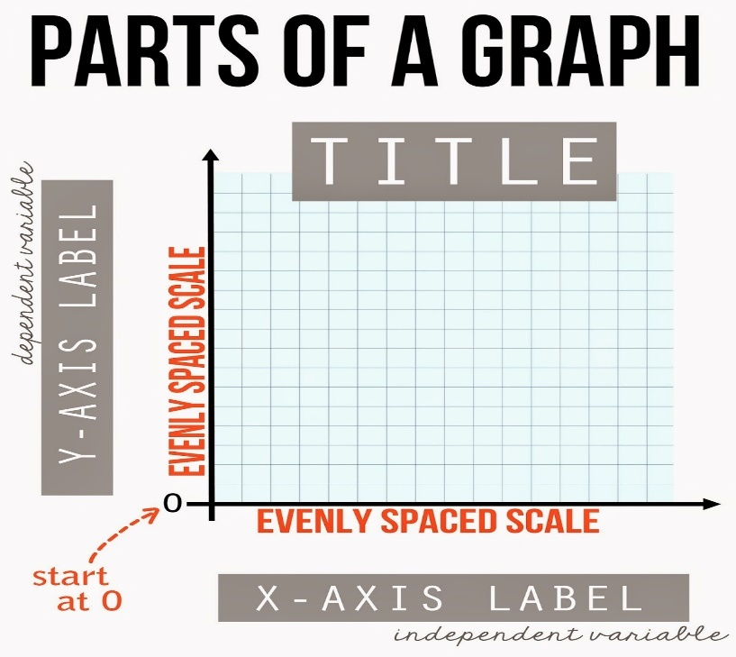
Create a Graph
Students should spend the remaining time for this club meeting creating a graphical summary of your data to include on your presentation slides. Make sure students have identified the appropriate type of graph for displaying the type(s) of data they wish to display.
The image below is a basic review of how to label a graph.

Slide 13
Make sure students save their files. They should create a slide in their PowerPoint so they can copy and paste the graphs/tables(s) they created.
Next club meeting, students will go over p-values and hypothesis testing with t-test and ANOVA.

