Slide 1
Lesson 11: Procedures
Summary: Students will work on their procedures.

Slide 2
Objectives
Introduce Students to Protocol for Writing Procedures
  Review provided procedures for the HSTA statewide survey (9th/10th grade projects)
  Review strategies for developing procedures for 11th/12th grade projects
Review Procedures Criteria on Scoring Sheet
Complete HOA #5

Slide 3
Introduction to Procedures
Now that students have a solid research question, they will write procedures to explain how they will collect data to test their null hypothesis. When conducting a research project, procedures are the step-by-step instructions that explain exactly how someone will carry out the research project. Procedures can be considered a “recipe” to complete a research project. Procedures need to be clear, detailed, and repeatable. Good research procedures should make it possible for anyone, even someone who has never seen the project before, to repeat the research project and get similar results.
For HSTA research projects, the research score sheet includes 11 required items designed to ensure the project’s procedures are clear, detailed, and well-structured. The procedures section is organized into four sections that align with one of the main types of research projects. Students should first identify which project type best matches their project, then carefully review the procedure requirements specific to that project type.

Slide 4
Cross-Sectional/Prevalence Study: This type of study examines a population at a specific point in time. If students are 9th/10th graders and working on the state survey, have them read over the items below, then read over Procedures for State Survey presented later in this lesson. If students are 11th/12th graders working on a Cross-Sectional/Prevalence Study, read the items below before they start writing procedures, and read over Procedures Tips for 11th and 12th Graders presented later in this lesson.
Procedures were numbered in the order that each step was completed.
Procedures identified all safety precautions (including how participants' identities will be kept confidential, i.e. CITI training completed).
Procedures explained who the study population was.
Procedures explained what the study population did.
Procedures explained how at least 100 participants were recruited.
Procedures included a copy of the measurement tools (i.e. survey/observation sheet).
Procedures included a participant cover letter explaining the project.
Procedures included data collection sheet.
Procedures explained how data was collected.
Procedures included how data will be analyzed (i.e. states the name of the statistical test to be used).
Procedures included a list of materials used for the project.

Slide 5
Intervention: An intervention is a structured program aimed at inducing change within a group. If students are 11th/12th graders working on a human intervention, read the items below before they start writing procedures, and read over Procedures Tips for 11th and 12th Graders presented later in this lesson.
Procedures were numbered in the order that each step was completed.
Procedures identified all safety precautions (including how participants' identities will be kept confidential, i.e. CITI training completed).
Procedures explained who the study population was.
Procedures explained details of the intervention.
Procedures explained how at least 30 participants were recruited.
Procedures included a copy of the pre and post measurement tools (Example: Survey/observation sheet).
Procedures included a participant cover letter explaining the project.
Procedures included data collection sheet.
Procedures explained how the pre and post data was collected.
Procedures included how data will be analyzed (i.e. states the name of the statistical test to be used).
Procedures included a list of materials used for the project.

Slide 6
Human Experiment: This involves conducting experiments with human participants to observe effects. If students are 11th/12th graders working on a human experiment, read the items below before they start writing procedures, and read over Procedures Tips for 11th and 12th Graders presented later in this lesson.
Procedures were numbered in the order that each step was completed.
Procedures identified all safety precautions (including how participants' identities will be kept confidential, i.e. CITI training completed).
Procedures explained who the study population was.
Procedures explained what the study population did.
Procedures explained how at least 30 participants were recruited for EACH group (experimental and control).
Procedures included a copy of the measurement tools (Example: Survey/observation sheet).
Procedures included a participant cover letter explaining the project.
Procedures included data collection sheet.
Procedures explained how data was collected.
Procedures included how data will be analyzed (i.e. states the name of the statistical test to be used).
Procedures included a list of materials used for the project.

Slide 7
Non-Human Experiment: This refers to traditional science experiments that test hypotheses using non-human subjects. If students are 11th/12th graders working on a non-human experiment, read the items below before they start writing procedures, and read over Procedures Tips for 11th and 12th Graders presented later in this lesson.
Procedures were numbered in the order that each step was completed.
Procedures identified all safety precautions (i.e. completely lab safety training).
Procedures explained what plant, natural resource, invertebrate (other) the project was experimenting with.
Procedures explained details of the experimental environment and/or change in environment (if you have more than one experimental group explain differences among all groups).
Procedures included a control group.
Procedures included a list of materials used for the project.
Procedures explained that there were at least 5 replications per experimental group.
Procedures included data collection sheet.
Procedures explained how data was collected.
Procedures included how data will be analyzed (i.e. states the name of the statistical test to be used).
Procedures provided a clear description of the project.

Slide 8
HOA #5: Procedures Part 1
This HOA is designed for students to practice writing clear procedures. Students will choose a topic, create a structure or item, and then write step-by-step instructions for how to build or complete it. In the next club meeting, students will exchange their written procedures with another group, who will follow the instructions to create the same structure or item. Afterward, the groups will compare their results, discussing any differences and how the procedures could be improved for clarity and accuracy.
Example topics:
Paper Snowflake or Airplane
Spaghetti and Marshmallow Christmas Tree Challenge
Gift Wrapping
Gingerbread House

Slide 9
Procedures for State Survey
For 9th and 10th grade projects, please follow the procedures outlined below. These are the same procedures we discussed in Lesson #. We provide these procedures for all State Surveys to help you, as a student researcher, learn how to write and follow directions effectively.
On your procedure slide, begin by copying down these procedures. Be sure to make any necessary edits and put a personal spin on the procedures. The words in green are guide words that you need to use and adjust as needed.

Slide 10
The procedures below are for 9th and 10th-grade projects. Words in green need to be edited by students. Walk through the procedures with students, use the words in Red as a guide.
Completed CITI training to learn about research ethics as a freshman in high school. Remind students of lesson 2 and their CITI training.
Used the HSTA State Survey 2025-2026 to collect community data on the insert the topic. Talk about why we are using the survey for 9th and 10th graders. We are learning about research.
Selected variables that we were interested in and asked a research question. Remind students of lesson when they read through the state survey to select two survey questions.
Worked on background research and other presentation elements during our HSTA Club. Remind students of lessons when they have completed their background research.
Shared the survey link from September 2025 – January 2026 with family, friends, and community members (Students should show a picture of how they shared the survey i.e. social media post, email). Students need to discuss a recruitment plan. How will they share the survey?
  Participants read a cover letter before they started the survey to learn about what types of questions were asked (Show cover letter in presentation).
Once the survey was closed, HSTA CRAs posted a password-protected raw data file for download. Tell students that once the survey is closed, HSTA CRAs will post all completed surveys in an Excel sheet. This Excel sheet will be protected by a password. They will be able to download the excel sheet and answer their research question. They will learn more about statistics, graphing, and writing conclusions with lessons 13 – 24.
Learned about statistics and graphing through HSTA club lessons.
Completed descriptive statistics and graphing to display data to describe the data set.
Completed insert statistical test name here to see if our data supported or rejected our null hypothesis.
Drew conclusions.

Slide 11
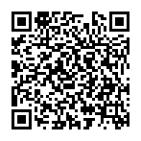
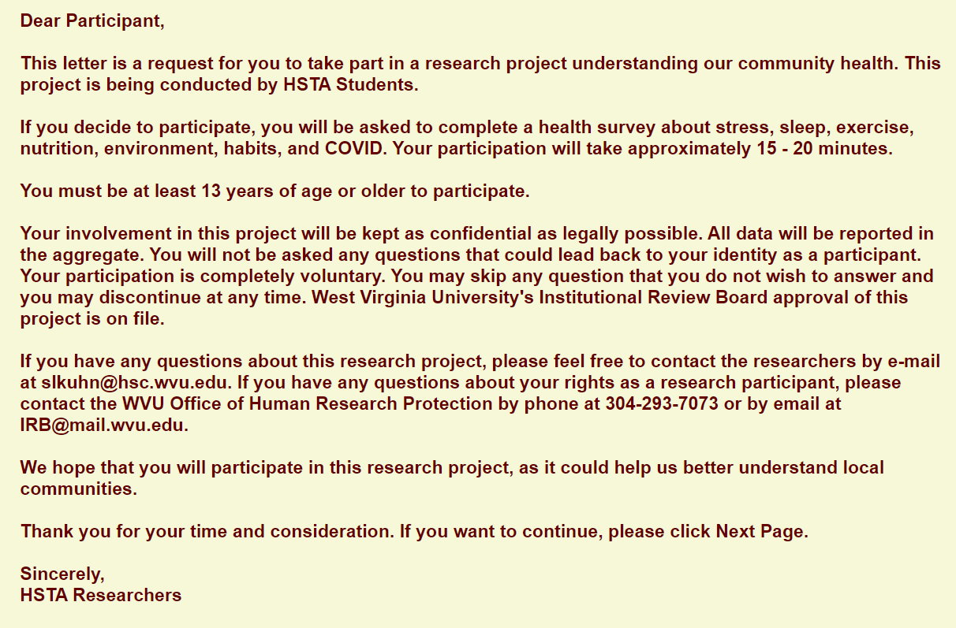
QR Code and Link for the 2025-2026 WV State Survey
Students should recruit through email, social media, word of mouth, etc., using the link and/or QR code below.
https://redcap.link/state2526
Cover Letter for 2025-2026 WV State Survey

