Slide 1
Lesson 10: Introduction to Excel and Data Collection Sheet
Summary: Students will work on their procedures and complete HOA.

Slide 2
Introduce Students to Excel
Generate a Data Collection Chart for the Research Project
Complete HOA #4

Slide 3
Excel is a powerful and widely used tool for data organization, analysis, and visualization. Throughout your project, you'll rely on Excel to analyze your results, perform calculations, and present your descriptive statistics and graphs clearly and professionally. Whether you're working with numbers, text, or dates, Excel provides an efficient and flexible platform to manage your data and extract meaningful insights.
There are numerous online resources available to help you master Excel, from beginner tutorials to more advanced techniques. To get started, a simple Google search using keywords like "Excel for beginners" or "Excel data analysis tutorial" will lead you to countless helpful guides, video tutorials, and practice exercises. Additionally, websites like Microsoft’s official support page, YouTube, and educational platforms such as Coursera and LinkedIn Learning offer in-depth courses to help you sharpen your Excel skills.
By taking advantage of these resources, you’ll be able to unlock Excel’s full potential and confidently analyze and present your data.

Slide 4
HOA #4
This HOA is designed to introduce Excel and HSTA’s data collection Excel sheet. Using the data from HOA #2, students can enter the data it into Excel, calculate averages/etc., create a graph, and answer the research question based on the averages and graphs.
OR Students can use example data sets to learn about Excel from lesson 18.

Slide 5
Data Collection Sheet
After learning a little more about Excel, HSTA students will create a data collection chart for their project. A data collection chart is a tool used to organize data during an experiment, survey, or other research activity. Data charts can be created in an Excel table, with rows and columns that help organize the information being collected.
Review the Data Collection Sheets below, and students need to select the one that best fits their research question and variables. Students will need to create their data collection chart and include it in their PowerPoint. The data collection sheet does not include raw data.

Slide 6
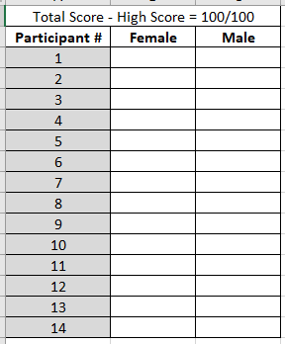
Prevalence Example
Is there a difference among gender and math scores?
Variables
  The Independent Variable is categorical
  The Dependent Variable is numeric
Project that has summation to get a total score.
After you score each ‘test/survey,’ enter your total scores for each participant.
Run an unpaired t-test because there are two different groups.

Slide 7
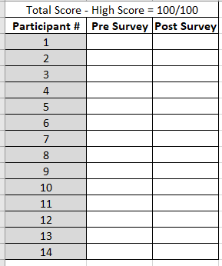
Intervention Example
Is there a difference in stress scores after the intervention?
Variables
  The Independent Variable is categorical
  The Dependent Variable is numeric
Test/Survey will need to have a ‘code’ to match pre and post to the same participant.
After you score each ‘test/score,’ enter your total scores for each participant. Surveys will have a coding system, replacing words with numbers (categorical coding).
Run a paired t-test because the same people took the pretest/survey as the posttest/survey.

Slide 8
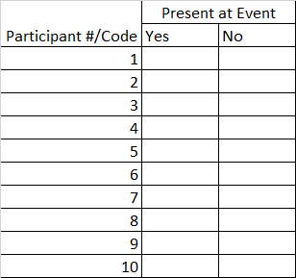
Project has Yes or No
Variables
  Variable One is categorical
  Variable Two is categorical
Make sure to enter the question or summarize the question. Then enter Yes or No in blank boxes.
Research Question: Difference among grade levels and if they are present at an event?
You would run a chi square.

Slide 9
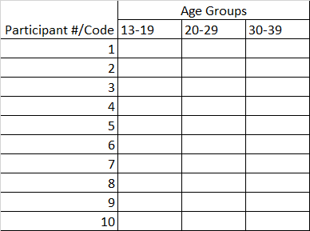
A project that has three groups
Variables
  The Independent Variable is categorical
  The Dependent Variable is numeric
Make sure to label your columns to match what you are collecting.
Research Question: Is there a difference among age groups and weight?
You would run an ANOVA because you have three groups to compare.

Slide 10
A project where you are looking for how much one variable tends to change when the other changes, collecting both variables.
Record | Rainfall | Temperature
1
2
3
4
5
6
7
8
9
10
Variables
  Variable One is numeric
  Variable Two is numeric
Make sure to label your columns. Column Rainfall and Temperature will be collected at the same time and then repeated.
Procedures will need to explain how and when records were collected.
Research Question: Does rainfall relate to temperature?
You would run a correlation.

Slide 11
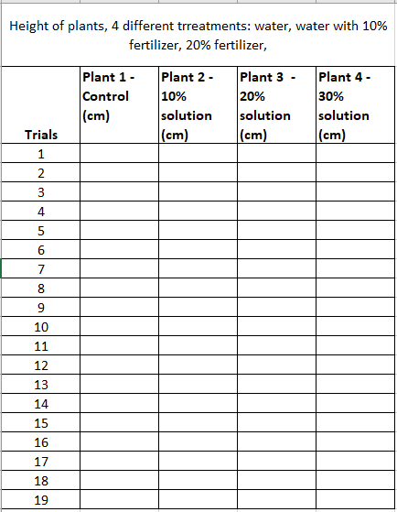
Non-human study, collecting data over time
Variables
  The Independent Variable is categorical
  The Dependent Variable is numeric
Make sure to set up your data sheet to collect data over time and record data for each group.
Research Question: Does plant height differ among fertilizer?
You would run an ANOVA.

