Slide 1
Backpack Safety
Knowledge Intervention
Team members’ names
High School
Teacher

Slide 2




01
Table of Contents
02
03
Introduction
Pre-test
Discussion

Slide 3
04
Table of contents
05
06
Supplemental Video
Post-test
Conclusion

Slide 4



Introduction
Hi! I’m [insert name here]. I am a student at [insert high school here] and a HSTA participant. [Share information about yourself/what you’ve done in HSTA thus far if you’d like to.]

Slide 5
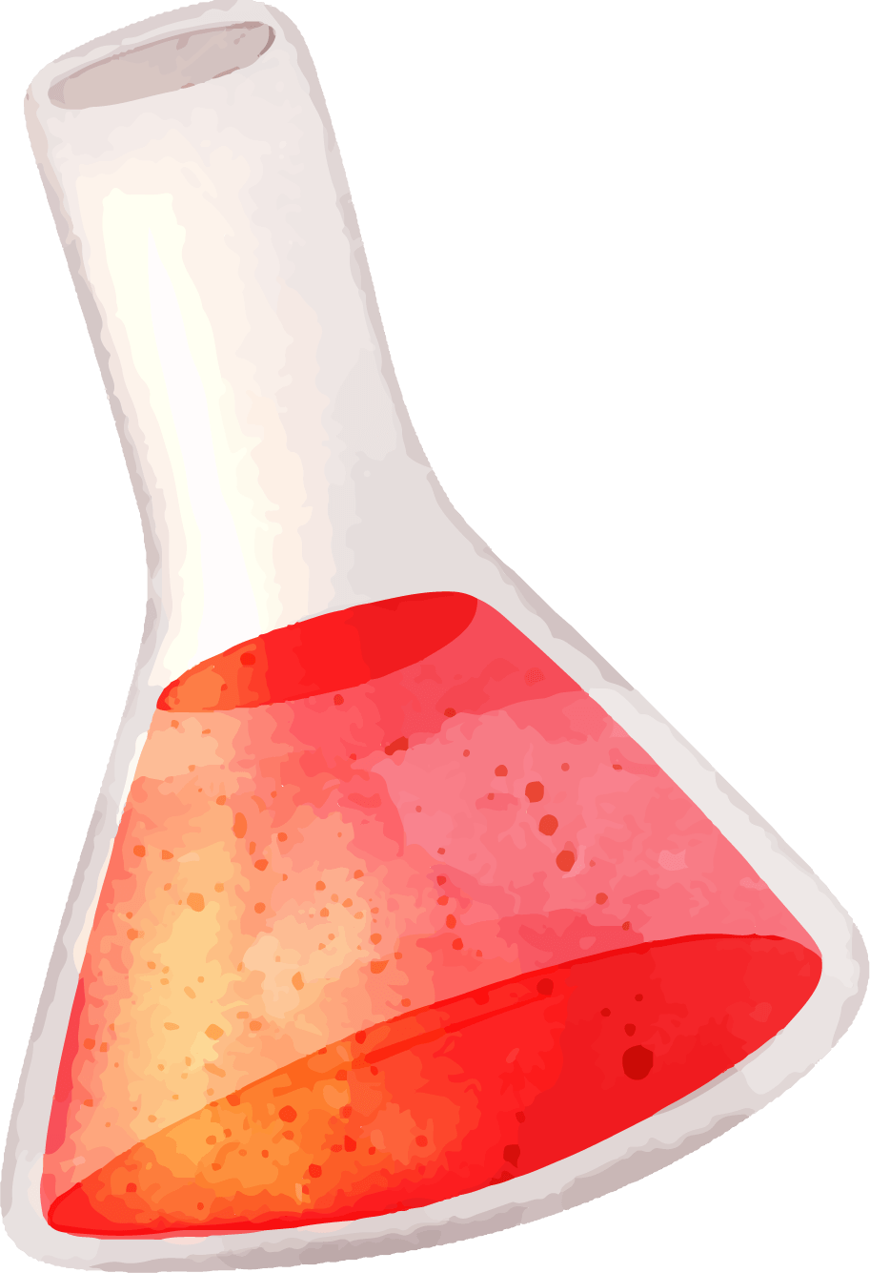
Pre-Test Time
Before we begin our activity, we will give you a ten question survey to see what you already know about backpack safety. Please take 5-10 minutes to complete this test independently.

Slide 6

Discussion
What makes improper backpack carrying so dangerous?
Premature spinal curvature
Muscle strain
Nerve compression
Fatigue
Reduced lung function
Balance issues
Impact on growth issues
  Students should only carry a backpack that is 10-15% of their body weight
How do you carry a backpack properly?
Choose the right backpack
  Lots of padding
  The more books you have, the bigger it should be
Use both shoulder straps
Maintain good posture
Pack the backpack wisely
  Heavy items to the back
  Carry only what you need
  Distribute weight evenly

Slide 7
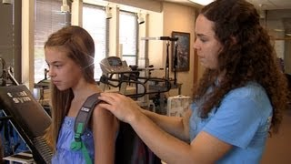
Supplemental Video

Slide 8
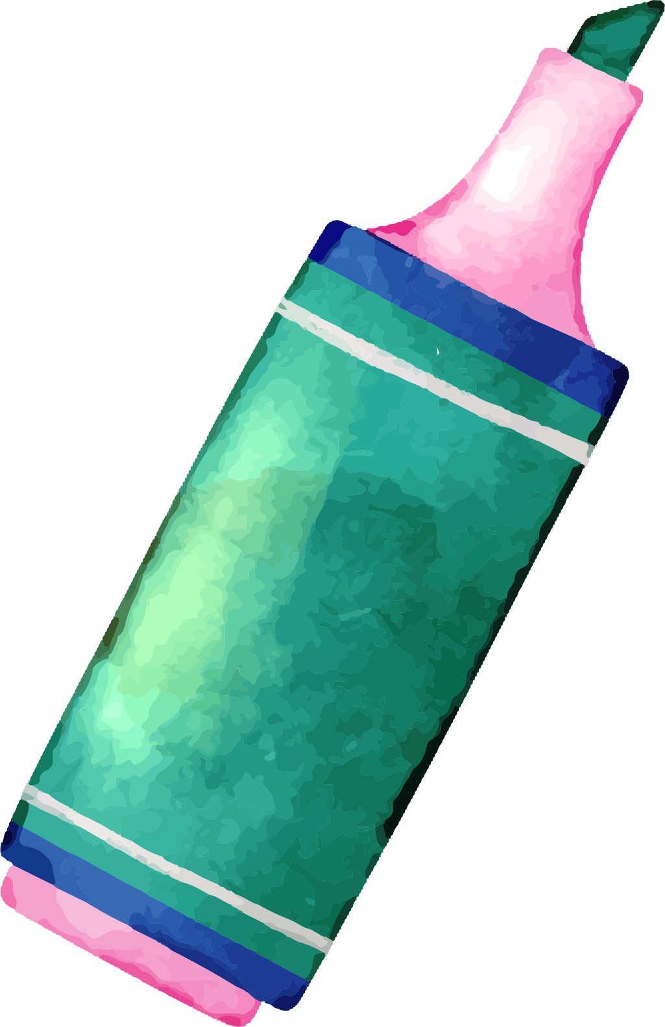
Post-Test Time
Please take another 5-10 minutes to fill out the post-test portion, independently.

Slide 9



Thank You!
Comments? Questions? Concerns?

