Slide 1
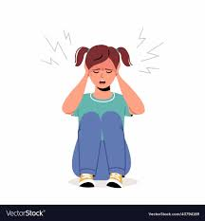
How Does Noise Damage Your
Hearing?
Knowledge Intervention
Name | HSTA Club/Region | HSTA Teacher

Slide 2
Table of contents
01
Introduction
04
Video
02
Pre-Test
05
Post-Test
03
Discussion
06
Wrap-up
Learn more about your HSTA facilitators
A supplemental video provided by the It's a Noisy Planet. Protect Their Hearing®
What do you know about damage caused by noise?
What have you learned about damage caused by noise?
What do you and your peers think? Were you aware of this potential damage?
Comments? Questions? Concerns?

Slide 3
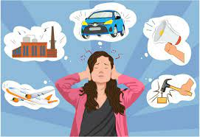
01
Introduction

Slide 4
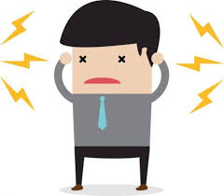
Hey there!
Hi! I’m [insert name here]. I am a student at [insert high school here] and a HSTA participant. [Share information about yourself/what you’ve done in HSTA thus far if you’d like to.]

Slide 5
02
Pre-Test

Slide 6
Pre- and Post-Test Format
Pre-Test
Post-Test
Before we begin our intervention, we will give you a ten question survey to see what you already know about damage caused by noise.
After our intervention, we will give you a post-test to see what you have learned about damage caused by noise.

Slide 7
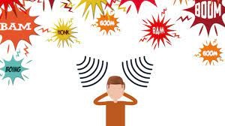
Pre-Test Time!
Survey
https://create.kahoot.it/details/45344d91-3565-46cb-a30a-6abc02450fb1
Take 5-10 minutes to complete the survey given to you by your HSTA facilitator. This is to be done individually.

Slide 8
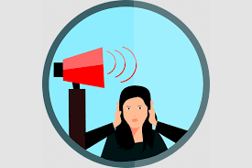
03
Discussion

Slide 9

How Does Noise Damage Your Hearing?
Exposure to noisy school cafeterias, loud music, movies, video games, sporting events, and other noisy activities can lead to noise-induced hearing loss. Noise-induced hearing loss:
Can build over time.
Is permanent.
Is preventable.
https://www.noisyplanet.nidcd.nih.gov/educators

Slide 10
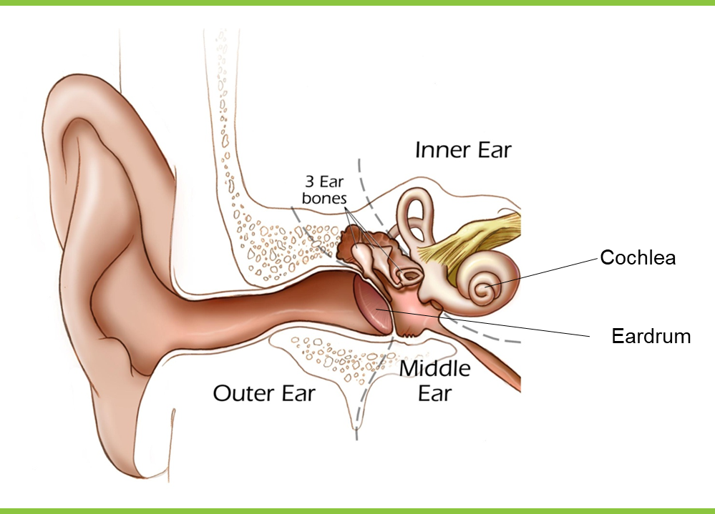
Ear captures sound by vibrations
Sound waves travel through outer and inner ear.
3 small bones amplify the sound vibrations to send them to cochlea
Sensory cell get activated by this

Slide 11
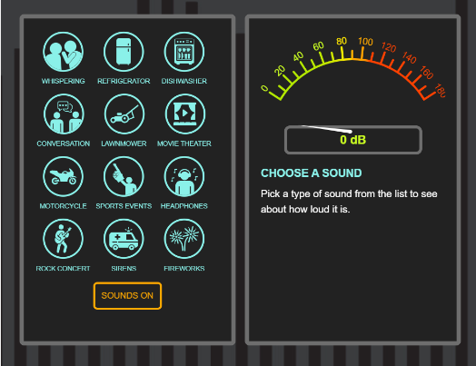
Is the Noise Too Loud?
Here are some rules of thumb to tell if the sounds around you are too loud: ¡ You find yourself speaking loudly or shouting so people an arm’s length away can hear you. (Or you have trouble hearing someone talking in a conversational volume when you’re an arm’s length away.) ¡ The noise hurts your ears. ¡ Your ears buzz or ring during the noise or after the noise goes away.
https://www.noisyplanet.nidcd.nih.gov/kids-preteens/listen-up-infographic

Slide 12
04
Supplemental Video

Slide 13
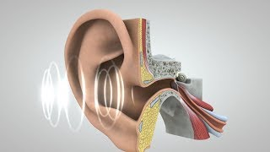
How does the sound travel?
https://dbzone.exploresound.org/

Slide 14
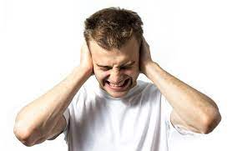
05
Post-Test

Slide 15
Post-Test Time!

Slide 16
06
Wrap-Up

Slide 17

Questions?
Comments?
Concerns?

