Slide 1
Water Pollution in West Virginia:
A Knowledge Intervention
Name | HSTA Region/Club | HSTA Teacher Name

Slide 2
Table of contents
01
02
03
04
05
06
Introduction
Pre-test
Discussion
Why are we doing this intervention, and what is HSTA?
What do you already know about water pollution in WV?
The who, what, why, when, and where of WV water pollution
Video
Post-test
Wrap-up
Questions? Comments? Concerns?
A supplemental video to contextualize this intervention
What have you learned about water pollution in WV after this intervention?

Slide 3
01
Introduction

Slide 4
First Things First…
Hi! I’m [insert name here]. I am a student at [insert high school here] and a HSTA participant. [Share information about yourself/what you’ve done in HSTA thus far if you’d like to.]

Slide 5
02
Pre-Test
Seeing what you know so we can measure what you’ve learned

Slide 6
Pre-Test
Post-Test
Before we begin our intervention, we will give you a ten question survey to see what you already know about water pollution in West Virginia.
After our intervention, we will give you a post-test to see what you have learned about water pollution in West Virginia.

Slide 7
Pre-Test Time!
Take 5-10 minutes to complete your survey. This is to be done individually.

Slide 8
03
Discussion
Notes:
Marcayla King, a HSTA student has a podcast about her research on PFAS. I’ll look for the site.

Slide 9
PFAS Fast Facts
Decreased vaccine response
Increased high blood pressure
Especially dangerous for children who ingest these chemicals
Can lead to strokes or death
Material usage
Kidney & testicular cancer
Increases risk for terminal diseases
“Used to make carpets stain-resistant and keep food from sticking to packaging” (Tony, 2023, para.
Notes:
https://www.epa.gov/pfas/pfas-explained more information. Testing kits to test school water as part of the project.

Slide 10
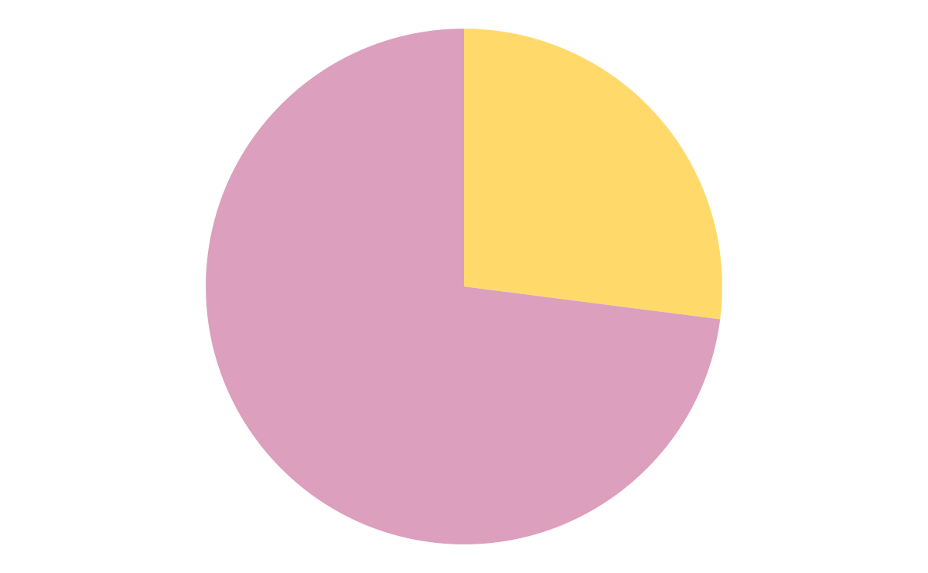
Water Systems in West Virginia
Systems without detectable PFAS
10
“PFAS are “industrial chemicals that don’t break down in the environment and can build up in the human bloodstream” (Tony, 2023, para. 9).
27
Systems with detectable PFAS

Slide 11
HB 3189
Legislation signed by Jim Justice in April 2023 which requires the Department of Environmental Protection to identify, address, and create solutions for water with detectable PFAS

Slide 12
04
Video
Supplemental content from NBC News

Slide 13
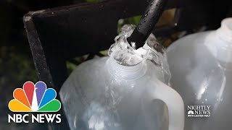
“‘There’s No Good Water’: West Virginia Community Lacks Critical Access”
What similarities or differences do you see to our own community in West Virginia?

Slide 14
Post-Test
05
What did you learn?

Slide 15

Post-Test Time!

Slide 16
06
Wrap-Up
Questions? Comments? Concerns?

Slide 17
Thank you!

