Slide 1
Can Social Media Be Addictive?
[Name] | [HSTA Club Here] | [HSTA Teacher Here]

Slide 2
Introduction
Hi! I’m [insert name here]. I am a student at [insert high school here] and a HSTA participant. [Share information about yourself/what you’ve done in HSTA thus far if you’d like to.]
Notes:
This is the slide where you will introduce yourself and share a little bit about your experience as a HSTA participant. Feel free to insert pictures here from summer camps or symposiums.

Slide 3
Before We Begin…
Pre-Test
Post-Test
Before we begin our activity, we will give you a ten question survey to see what you already know about media addiction.
After our activity, we will give you a post-test to see what you have learned about media addiction after our intervention.
Notes:
This is where you will introduce the concept of pre-test and post-test to your intervention group. This gives you some time to explain what you will be asking on the survey, why you are asking it, and how you plan on using this data to complete your HSTA project.

Slide 4

Pre-Test Time!

Slide 5
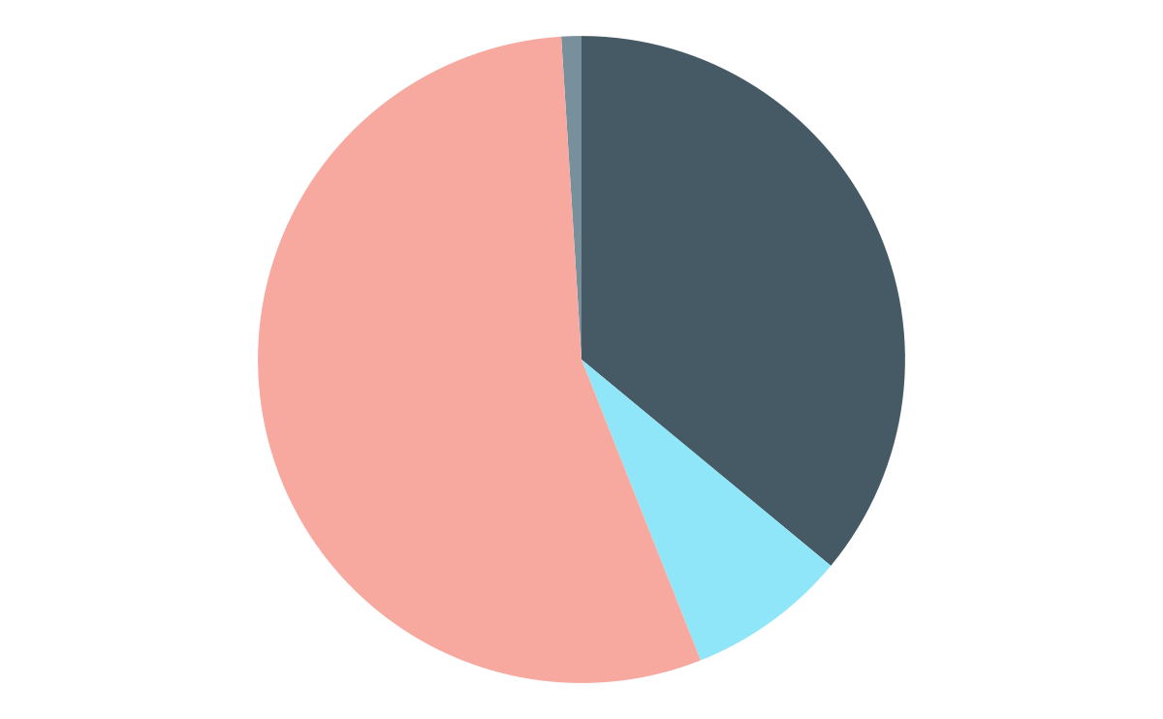
“% of U.S. teens who say that overall, the amount of time they spend on social media is…”
55%
36%
<1%
8%
About right
Too much
Don’t know
Too little
54% of teens “say that it would be too hard to give up social media” (Atske, 2022).
Notes:
This is where you will begin to introduce the knowledge concepts that are included on the pre-and post-test. Be sure to go over these slides and schedule a practice run with your HSTA GA before you give this intervention to middle school students.

Slide 6
—(Atske, 2022, para. 10).
“Since 2014-15, there has been a 22 percentage point rise in the share of teens who report having access to a smartphone (95% now and 73% then)”

Slide 7
Daily Internet Usage
97%
of teens say that they use the internet daily (Atske, 2022)

Slide 8
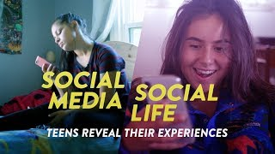
Social Media/ Social Life: Teens Reveal Their Experiences
While watching the video, think about your own social media usage: do you think you are using social media too much? Why or why not?
Notes:
Use this slide to facilitate some discussion with your students. Do they have these issues themselves? What positives do they see about social media? What negatives do they also see?

Slide 9
Video Key Takeaways
Always “on”
Mental health
Hate speech
Staying connected
These students reveal that they are always on their phone - whether at school, at home, or walking in between
These folks feel emotionally attached, charged, and transformed by their social media usage
Students see and read hate speech online at an alarming rate
These students use social media as a platform to connect, whether it be about social issues, sharing art, or talking to friends
Notes:
This slide is to wrap up your discussion and facilitate conversation.

Slide 10
Post-Test Time!

Slide 11
References
Atske, S. (2022, December 15). Teens, Social Media and Technology 2022 | Pew Research Center. Pew Research Center: Internet, Science & Tech. https://www.pewresearch.org/internet/2022/08/10/teens-social-media-and-technology-2022/
Can Media Be Addictive? (2021). Common Sense Education. https://www.commonsense.org/education/digital-citizenship/lesson/can-media-be-addictive?check_logged_in=1

