Slide 1

Self-Esteem
And Teens

Slide 2
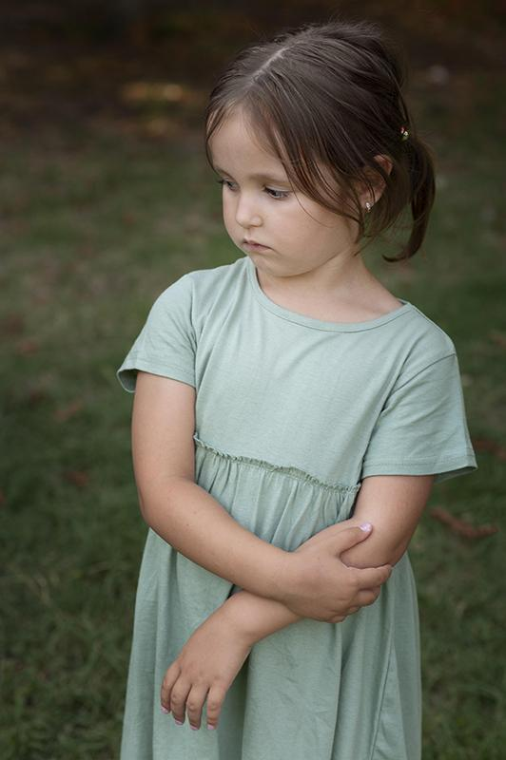
01
Introduction

Slide 3
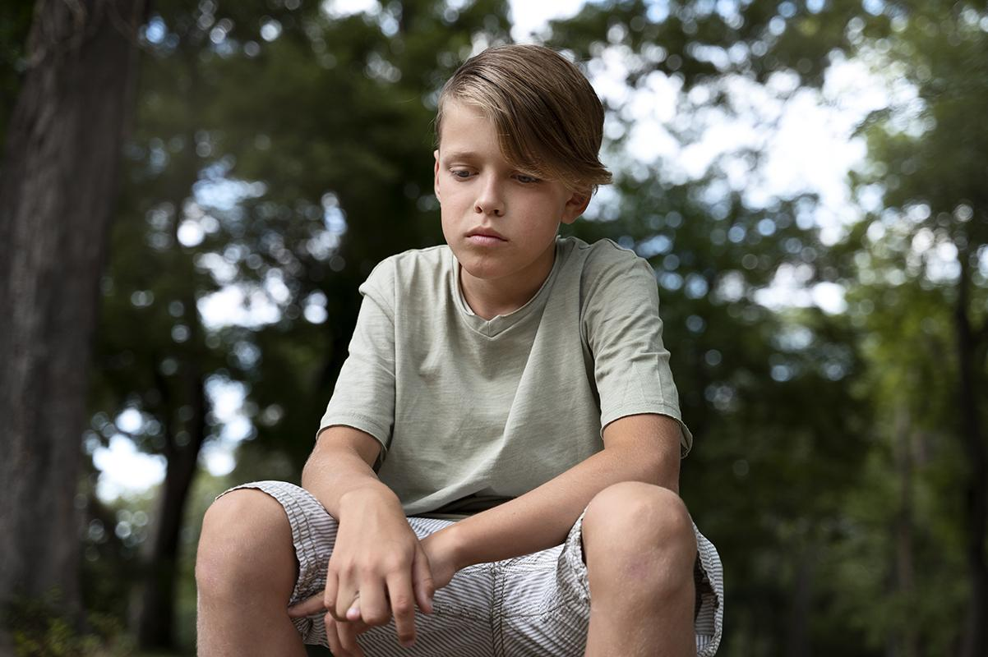
02
Pre-Test

Slide 4

What is self-esteem?
Self-esteem is a self-assessment, in other words, it is a set of perceptions, thoughts and feelings about ourselves which will determine our way of behaving and relating with others

Slide 5
Levels of self-esteem
Having the strength to express your emotions and feelings without shame
Taking your own decisions without expecting the approval of others
Accepting themselves without being affected by other people’s opinions
A person with high self-esteem is characterised by:
Having a more positive attitude to life and, in particular, when faced by adversity
Having more compassion for yourself in the event of a mistake or failure
Being more empathetic with others by understanding their feelings and the ways in which they think

Slide 6
Levels of self-esteem
Having difficulty in setting limits or saying no when you feel or believe it is necessary
Getting despondent easily with the first obstacle that appears
Pessimistic attitude towards life
A person with low self-esteem is characterised by:
Conditioning their own decisions based on what others think or expect
Finding it difficult to accept yourself
Being ashamed and scared of expressing your emotions and feelings
Being less empathetic to others as you are highly immersed in emotions of fear, insecurity and mistrust

Slide 7
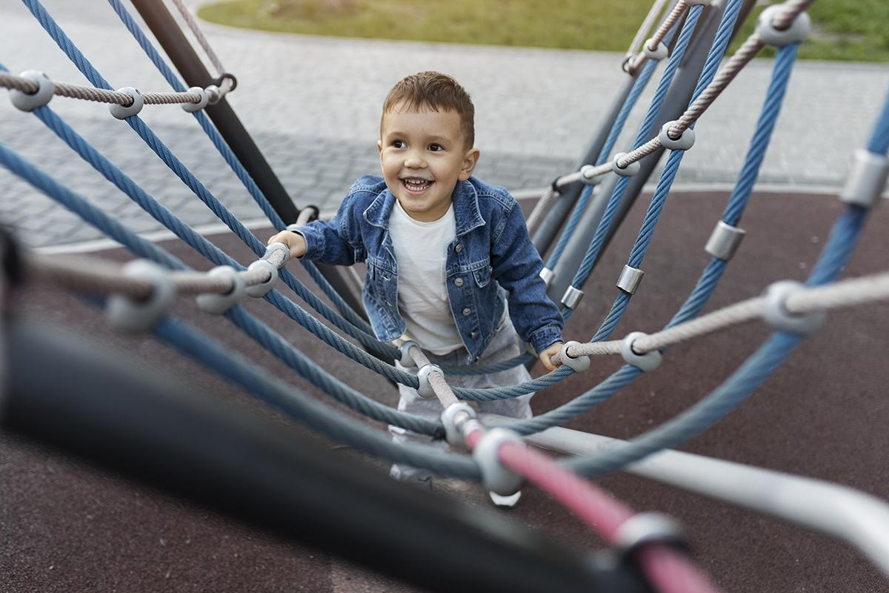
Development of self-esteem
Self-esteem is gradually built up as with self-concept from early childhood and it gradually becomes more complex as development progresses
There is ever more social comparison and the assessments that they carry out of themselves are more objective and realistic (before the age of 6 children usually have very positive self-esteem)
From the age of 7-8 years old, self-esteem begins to consolidate and is more general in nature than at younger ages, and is a habit that continues for life

Slide 8
How do you know when a child has developed their self-esteem?
They feel respected
They assume responsibility for their acts
They are resilient and feel proud, even when they make mistakes
They feel comfortable and safe when they strike up personal relationships
They are endowed with a feeling of control over the activities and events of their lives
They have the courage to take good decisions, even when pressured by
their colleagues
They act independently

Slide 9
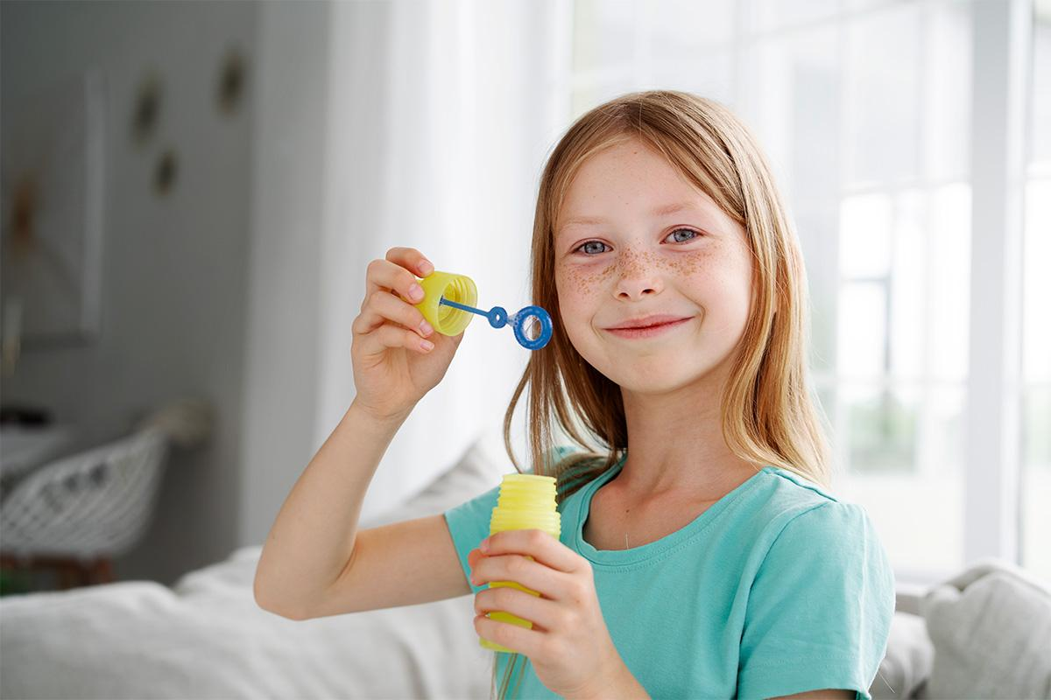
Strategies for promoting self-esteem in children
Both in the classroom and at home, the attitude of parents and teachers is vital:
Taking seriously their emotions and feelings
Letting them take decisions appropriate for their development level from a young age: they must learn to choose and to face risks
Serving as an example to your children (or students) and helping to face failures. You can’t always win, it is important to take part and have fun. Sharing, enjoying and learning are vital in life
Offering them new opportunities to carry out activities

Slide 10
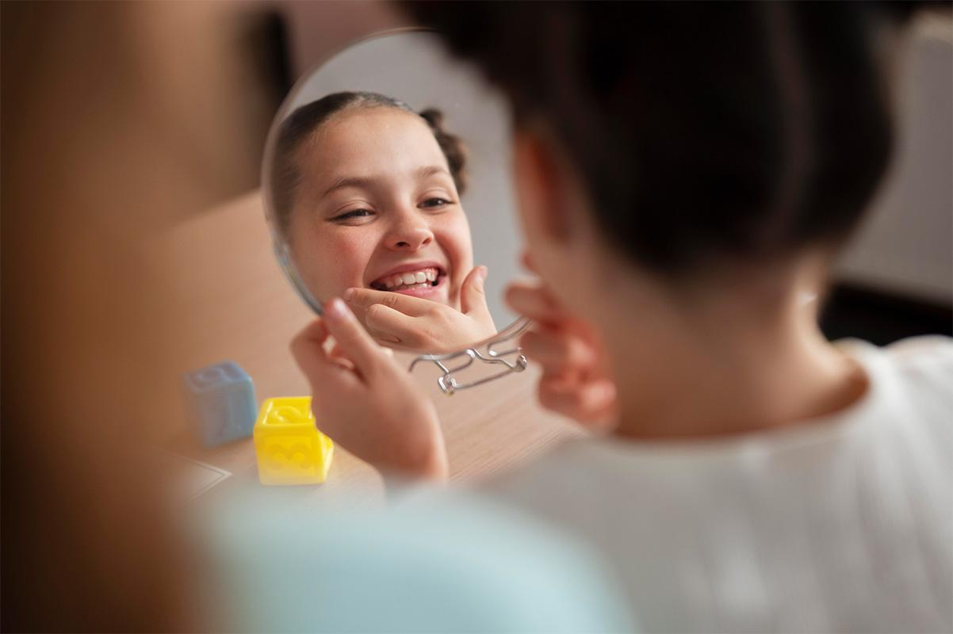
Strategies for promoting self-esteem
Listening to children
A child must learn to solve their problems. Let them solve any problems they have themselves. And also give them the tools to achieve this
Positively reinforce their initiatives, their successes, their decision-making, their solution to a problem, their efforts in sports and studies…
Reinforce with activities that please them and which they enjoy

Slide 11
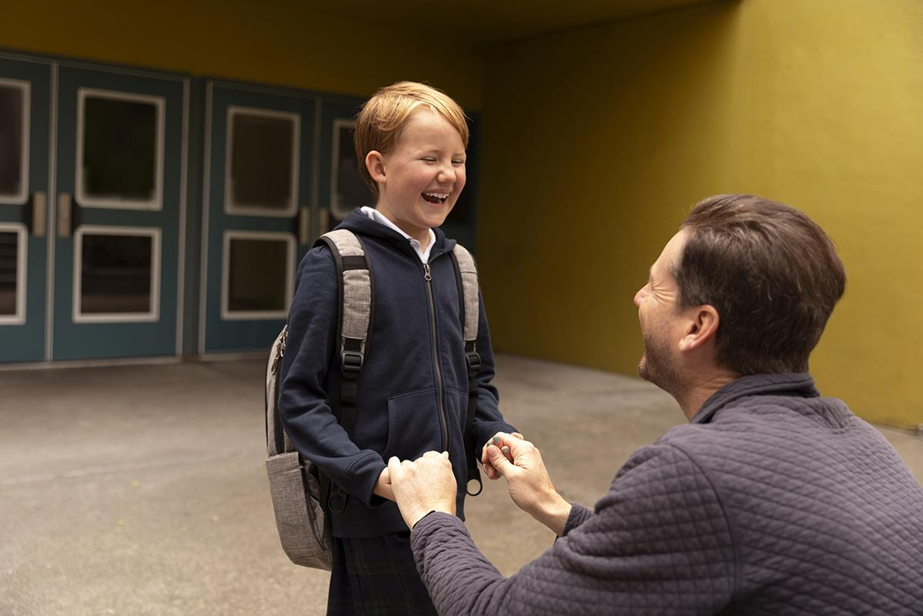
03
Post-Test

Slide 12
Thank you!
Any questions?

