Slide 1
National Drug & Alcohol IQ Challenge
Name | HSTA Region/Club | HSTA Teacher Name

Slide 2
Introduction
Hi! I’m [insert name here]. I am a student at [insert high school here] and a HSTA participant. [Share information about yourself/what you’ve done in HSTA thus far if you’d like to.]

Slide 3

Table of contents
Pre-Test
Discussion
01
02
Post-Test
Conclusion
03
04
What do you already know about Drugs and alcohol?
What do you and your peers know?
What did you learn after this intervention?
Wrap up.
Questions and comments.

Slide 4
01
Pre-Test

Slide 5

What is a Pre-Test/Post-Test?
Pre-Test
Post-Test
Before we begin our intervention, we will give you a ten question survey to see what you already know about drugs and alcohol.
After our intervention, we will give you a post-test to see what you have learned about drugs and alcohol.

Slide 6
Pre-test Time!
Take 5-10 minutes to complete the survey provided by your HSTA facilitator. This is to be done individually.
Survey

Slide 7
02
Discussion

Slide 8
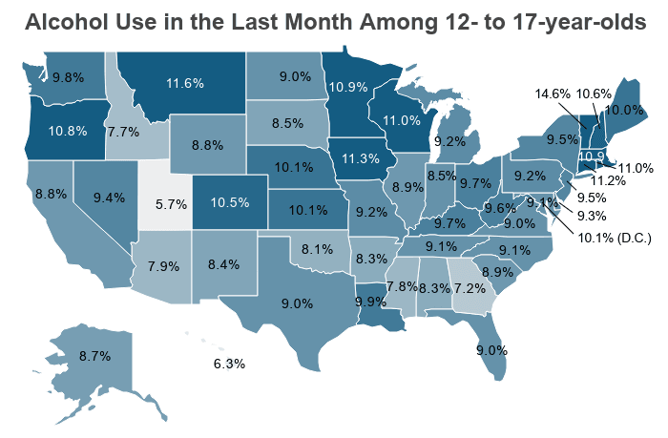
Alcohol is by far the most commonly abused substance among teens and young adults
https://drugabusestatistics.org/teen-drug-use/

Slide 9
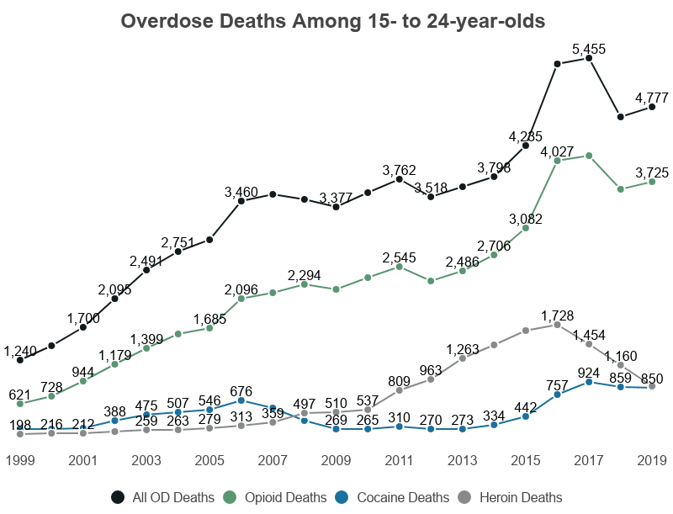
drug abuse corelates with substance abuse problems later in life, and the most significant increases in destructive behavior appear to take place among older teens and young adults.
https://drugabusestatistics.org/teen-drug-use/

Slide 10
West Virginia
Teens who use drugs
Teens who drink
8.78%
9.58%
Substance Abuse Among 12- to 17-year-olds
Percentage of teens who report drug use in the last month, and percentage of teens who report alcohol use in the last year, respectively.
https://drugabusestatistics.org/teen-drug-use/

Slide 11
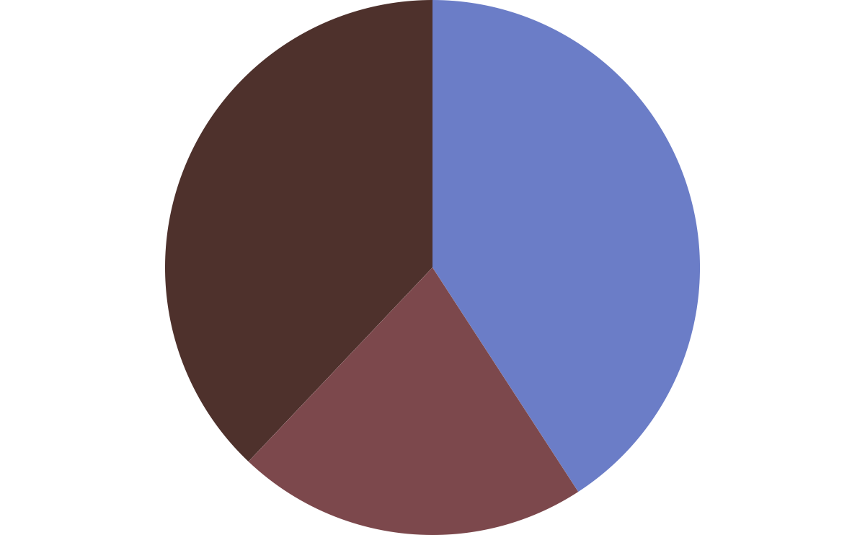
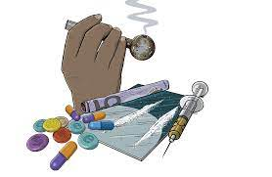
West Virginia Smokers by Age
25 - 34
55-64
65 & older
24.8%
26.7%
13.9%

Slide 12
National Drug and Alcohol IQ Challenge"
Activity
https://wv.pbslearningmedia.org/resource/nida-iq-challenge/nida-national-drug-alcohol-iq-challenge/
Which of these issues do you see reflected in your school with your peers?

Slide 13
04
Post-Test

Slide 14
Post-test Time!
Take another 5-10 minutes to complete the survey your HSTA facilitator gives you.
Survey

Slide 15
Thank
you!

