Slide 1


WHY WVU.
WEST VIRGINIA UNIVERSITY is a family of distinctive campuses united by a single mission.
From the groundbreaking research and health sciences focus of our flagship in Morgantown to the career-oriented programs of WVU Potomac State in Keyser to the technology-intensive programs at WVU Tech in Beckley — we are leveraging our talents and resources to create a better future for West Virginia and the World.

Slide 2


INSPIRED BY OUR STATE.
West Virginia University has a unique perspective on health. Our primary mission is to improve the health and well-being of everyone we serve by cultivating exceptional health professionals, solving real problems and caring for our people and communities.
WVU has the state’s only COMPREHENSIVE ACADEMIC HEALTH SCIENCES CENTER – a place where educators, healthcare professionals and scientists work together to advance human health.
We collaborate with people and communities to help build a culture of health, well-being and hope. Partnerships with health professionals and citizens across West Virginia allow us to plan and conduct community-based research that addresses addiction, chronic illness, rural health and health policy.

Slide 3
A MISSION OF CARE.
We believe our role as an academic health center is to solve real problems and transform the lives of our citizens. Across five health schools and numerous centers and institutes, that duty is woven through EXCELLENCE IN EDUCATION, RESEARCH, SERVICE and PATIENT CARE.
Students benefit from the opportunity to work alongside world-class practitioners and scientists and participate in groundbreaking research – it’s an environment that encourages curiosity, fosters innovation and champions patient-centric care.
Partnering with hospitals, clinics, health facilities and community organizations across the state, our students get HANDS-ON EXPERIENCE and UNIQUE TRAINING through rotations, residencies and other educational opportunities on the frontlines of modern patient care.
In the classroom, INTERPROFESSIONAL EDUCATION experiences provide purpose-driven opportunities for students to engage in immersive, skill-based learning with others outside their discipline and across campus to prepare them to work as a collaborative practice team, ultimately improving outcomes for patients and populations.

Slide 4
THREE HEALTH SCIENCES CAMPUSES – ONE VISION FOR HEALTH.*
CHARLESTON
Regional campus training students at Charleston Area Medical Center, located in the state’s capital.
EASTERN
Regional campus providing a community-centered approach to education with a focus on rural health.
MORGANTOWN
Largest concentration of healthcare, research and health professions resources in West Virginia.
*The School of Nursing offers programs in Beckley, Bridgeport, Charleston, Keyser and Morgantown.

Slide 5
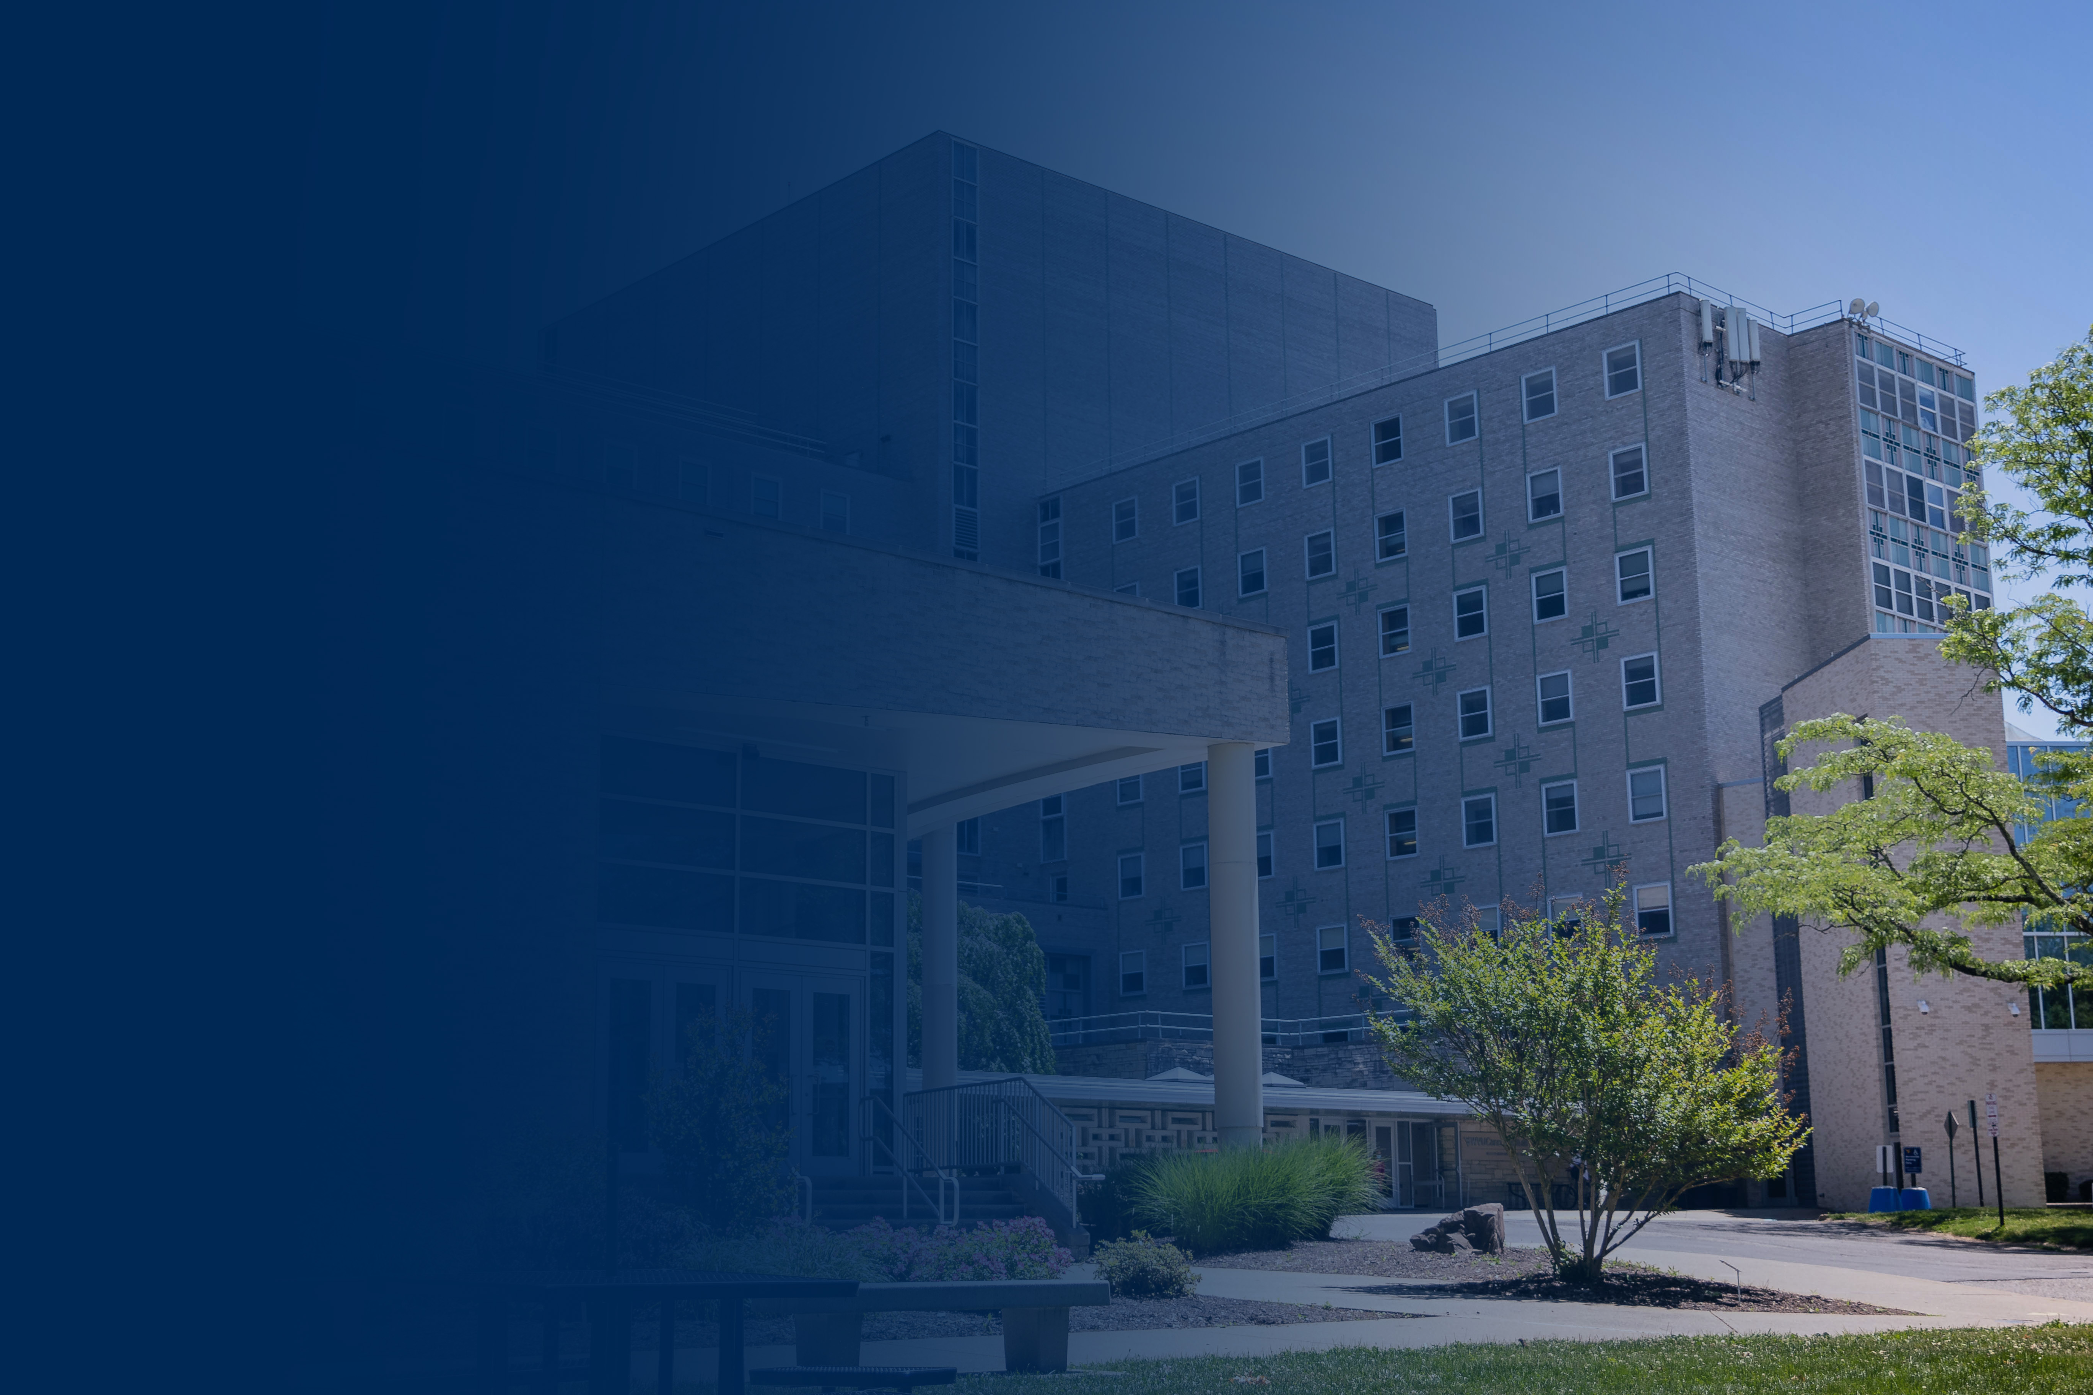
OUR COMMUNITY.
1 ACADEMIC HEALTH CENTER
housing all health sciences schools
5 SCHOOLS Dentistry Medicine
Nursing Pharmacy
Public Health
60+ DEGREE AND CERTIFICATE PROGRAMS
bachelor’s, master’s and doctorate level
80+ RESIDENCY AND FELLOWSHIP PROGRAMS
in dentistry, medicine, pharmacy and public health
3,892 STUDENTS increase of 350 since 2019
600 RESIDENTS increase of 200 since 2018
100 COMMUNITY SERVICE HOURS completed by most students
1,500+ NEW FACULTY recruited since 2016
60+ RESEARCH LABS
awarded more than $100 MILLION in grants

Slide 6
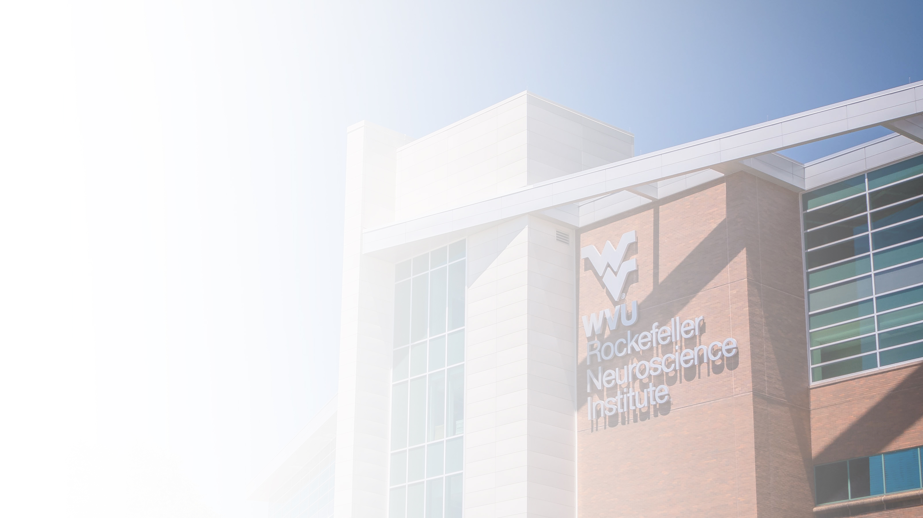
EXCELLENCE IN TREATMENT, PREVENTION AND RESEARCH.
Understanding, and eliminating, vexing health problems requires specialists and researchers who are collaborating across the university and with peers and partners in the industry. We are advancing care in Alzheimer's disease, cancer research and treatment, heart and vascular care, as well as developing strategies to combat the country’s opioid crisis.
/ WVU Cancer Institute
/ WVU Critical Care & Trauma Institute
/ WVU Heart & Vascular Institute
/ WVU Rockefeller Neuroscience Institute
/ WVU Eye Institute
/ WVU Center for Excellence in Disabilities
/ West Virginia Clinical & Translational Science Institute
/ West Virginia Prevention Research Center
/ WVU Center for Diabetes and Metabolic Health
/ WVU Injury Control Research Center
/ WVU Office of Health Services Research
/ West Virginia Geriatric Education Center

Slide 7
RESEARCH IS OUR STRENGTH.
At West Virginia University, we know the power of curiosity drives the engine of progress.
WVU is designated an R1: DOCTORAL UNIVERSITY – the highest level of research activity – by the Carnegie Classification of Institutes of Higher Education.
One of only five flagship R1 land-grant community engaged universities, WVU Health Sciences laboratories are attracting the best and brightest talent from around the country and the world.
We’re breaking down barriers between academic disciplines, schools and colleges and building multidisciplinary research teams to address important health problems in our state and nation.
At WVU, graduate and undergraduate students are key members of our laboratory teams and collaborate with – and learn from – established scientists.

Slide 8
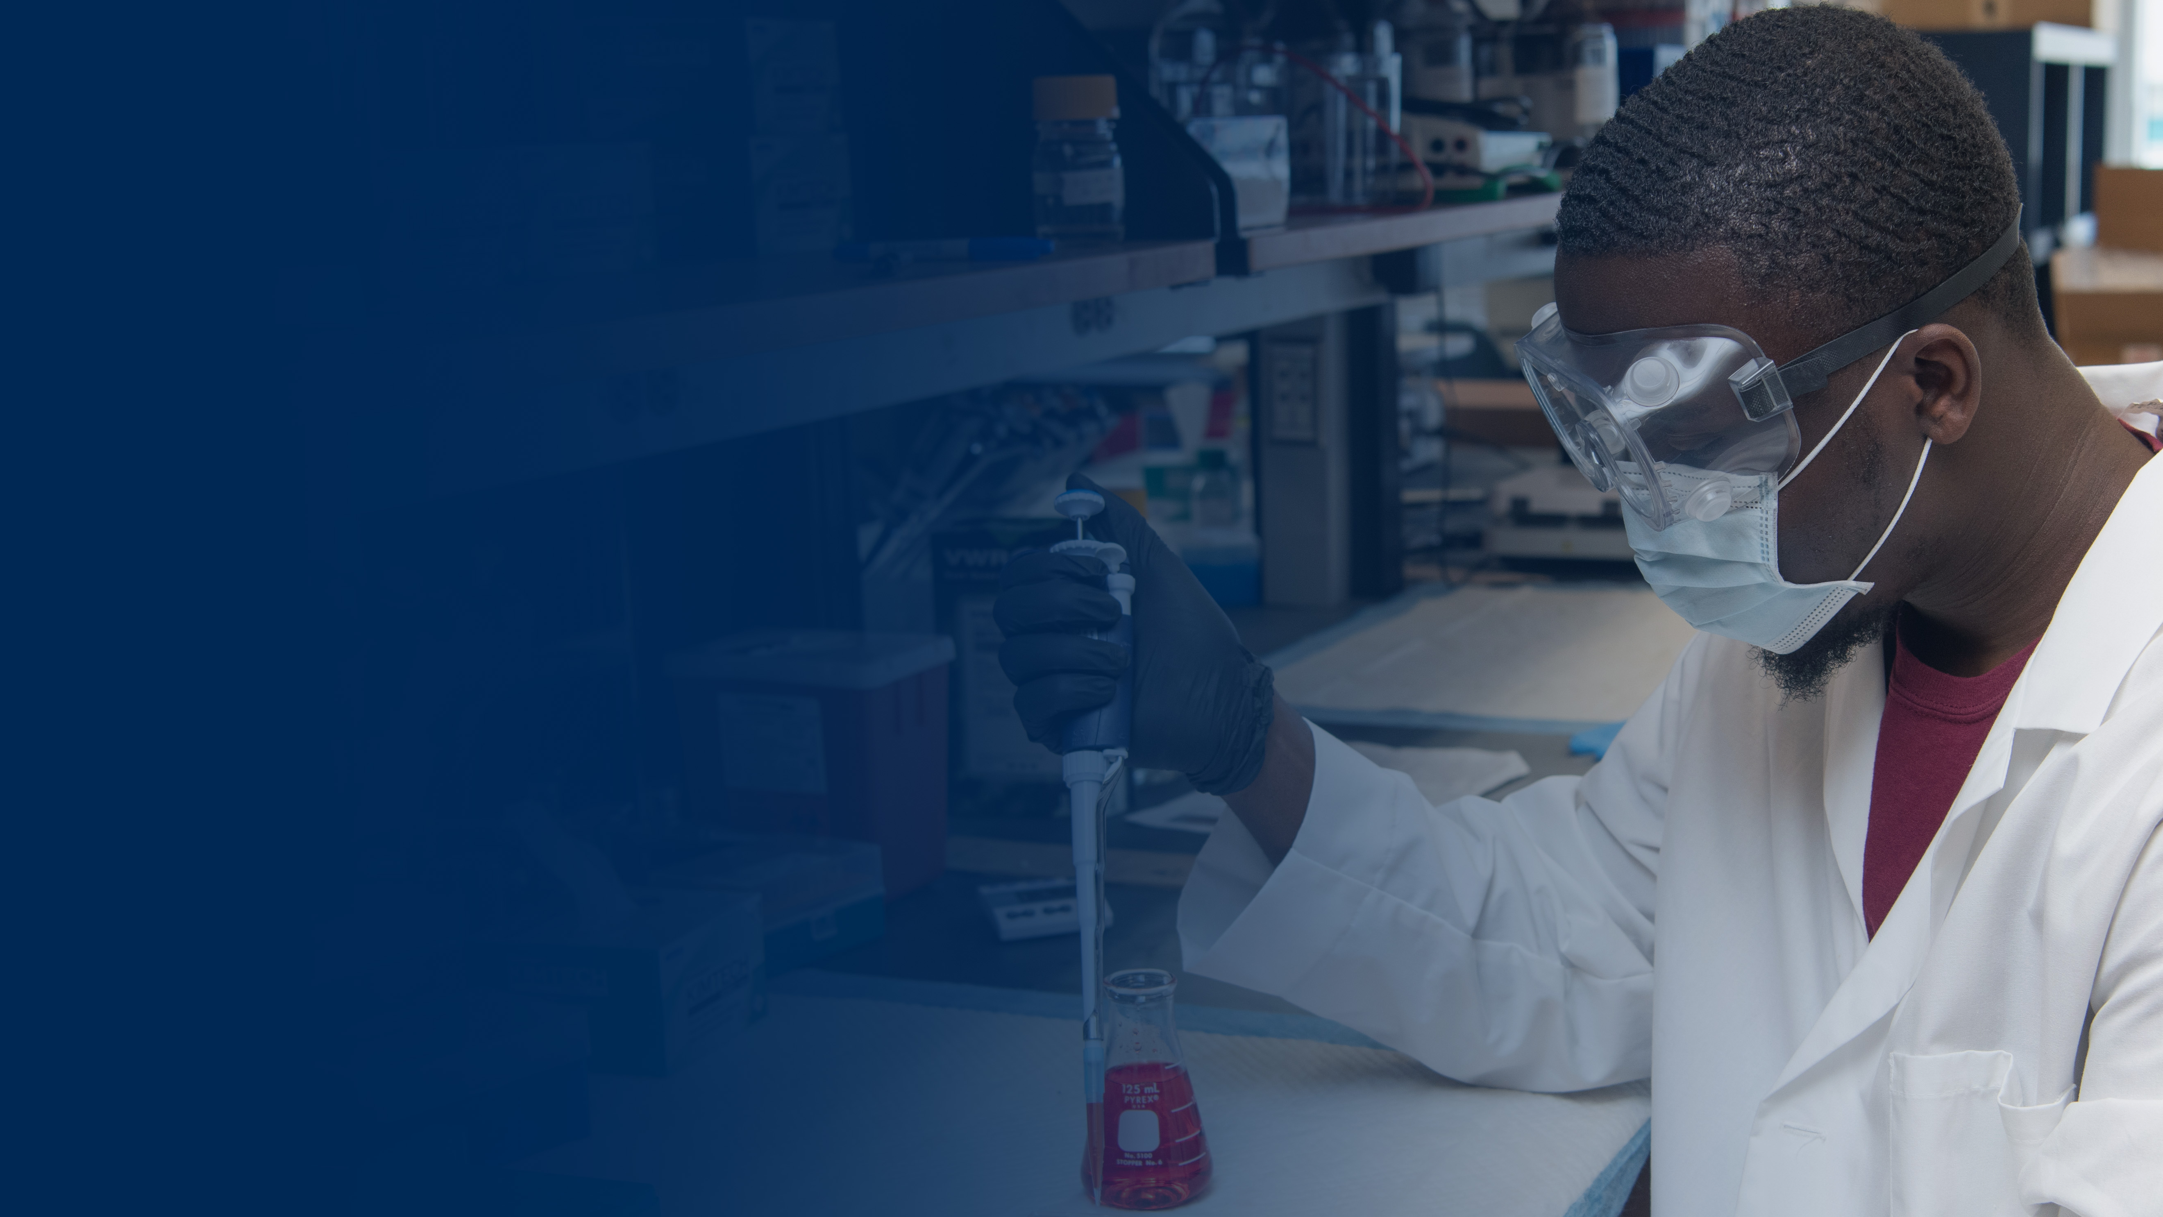
NIH CENTERS OF BIOMEDICAL RESEARCH EXCELLENCE.
$44.7M
Stroke
Experimental Stroke Core and Rodent Behavior Core
Tumor Microenvironment
Flow Cytometry Core and Animal Imaging Core
Visual Sciences
Visual Function and Morphology Core
NIH T32 TRAINING GRANTS.
$30.1M
Behavioral and Biomedical Sciences Interface
89 Traineeships (2008-2024)
Stroke and Its Alzheimer’s Related Dementias
70 Traineeships (2017-2026)
Cell & Molecular Biology and Biomedical Engineering
27 Traineeships (2019-2024)
Systems Toxicology
24 Traineeships (2022-27)
Notes:
Data Source: Fall 2022 Health Sciences leadership retreat

Slide 9

A HEALTH SYSTEM FOR THE STATE.
WVU MEDICINE is West Virginia University’s affiliated health system, West Virginia’s largest private employer and a national leader in patient safety and quality.
23
member system hospitals
28,620 employees
400+
medical residents and fellows
3.8 MILLION
clinic visits
94,215
surgeries
6,954
births
Notes:
Data Sources: Fall 2022 Health Sciences leadership retreat, 2022 Annual Report

Slide 10
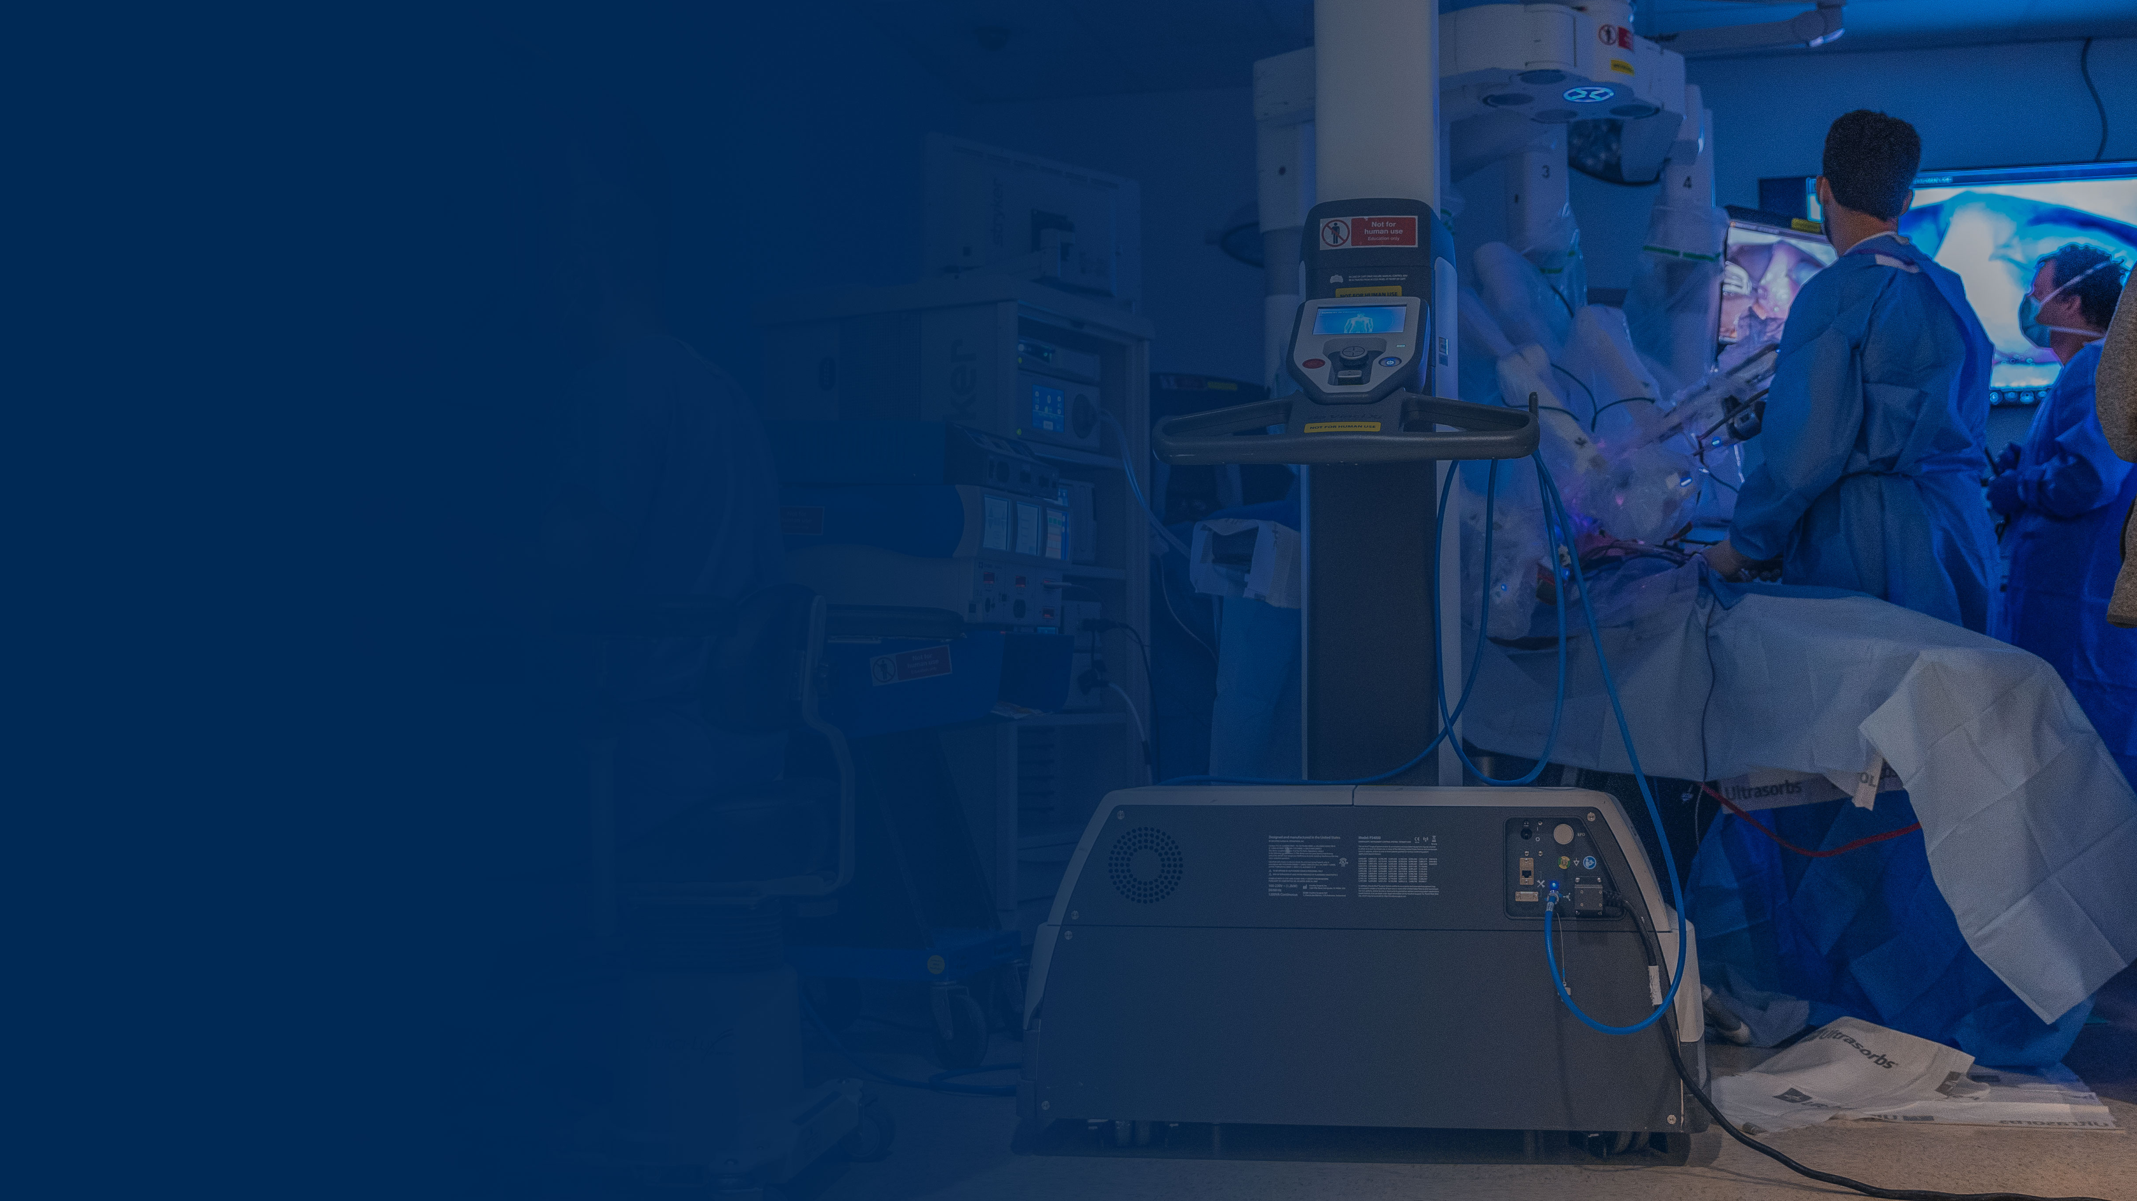
PRACTICE BEFORE YOU PRACTICE.
The DAVID AND JO ANN SHAW CENTER FOR SIMULATION TRAINING AND EDUCATION FOR PATIENT SAFETY (STEPS) is a state-of-the-art facility at WVU’s Health Sciences Center delivering innovative inter-professional health care training.
20,000+ SQ. FT.
instructional space
20-BED
open lab space
4 ICU SETUPS
with lifelike manikins
12 EXAM ROOMS for physical diagnosis and communication
3 SPECIALTY UNITS
OB and pediatric practice, operating room, surgical education

Slide 11
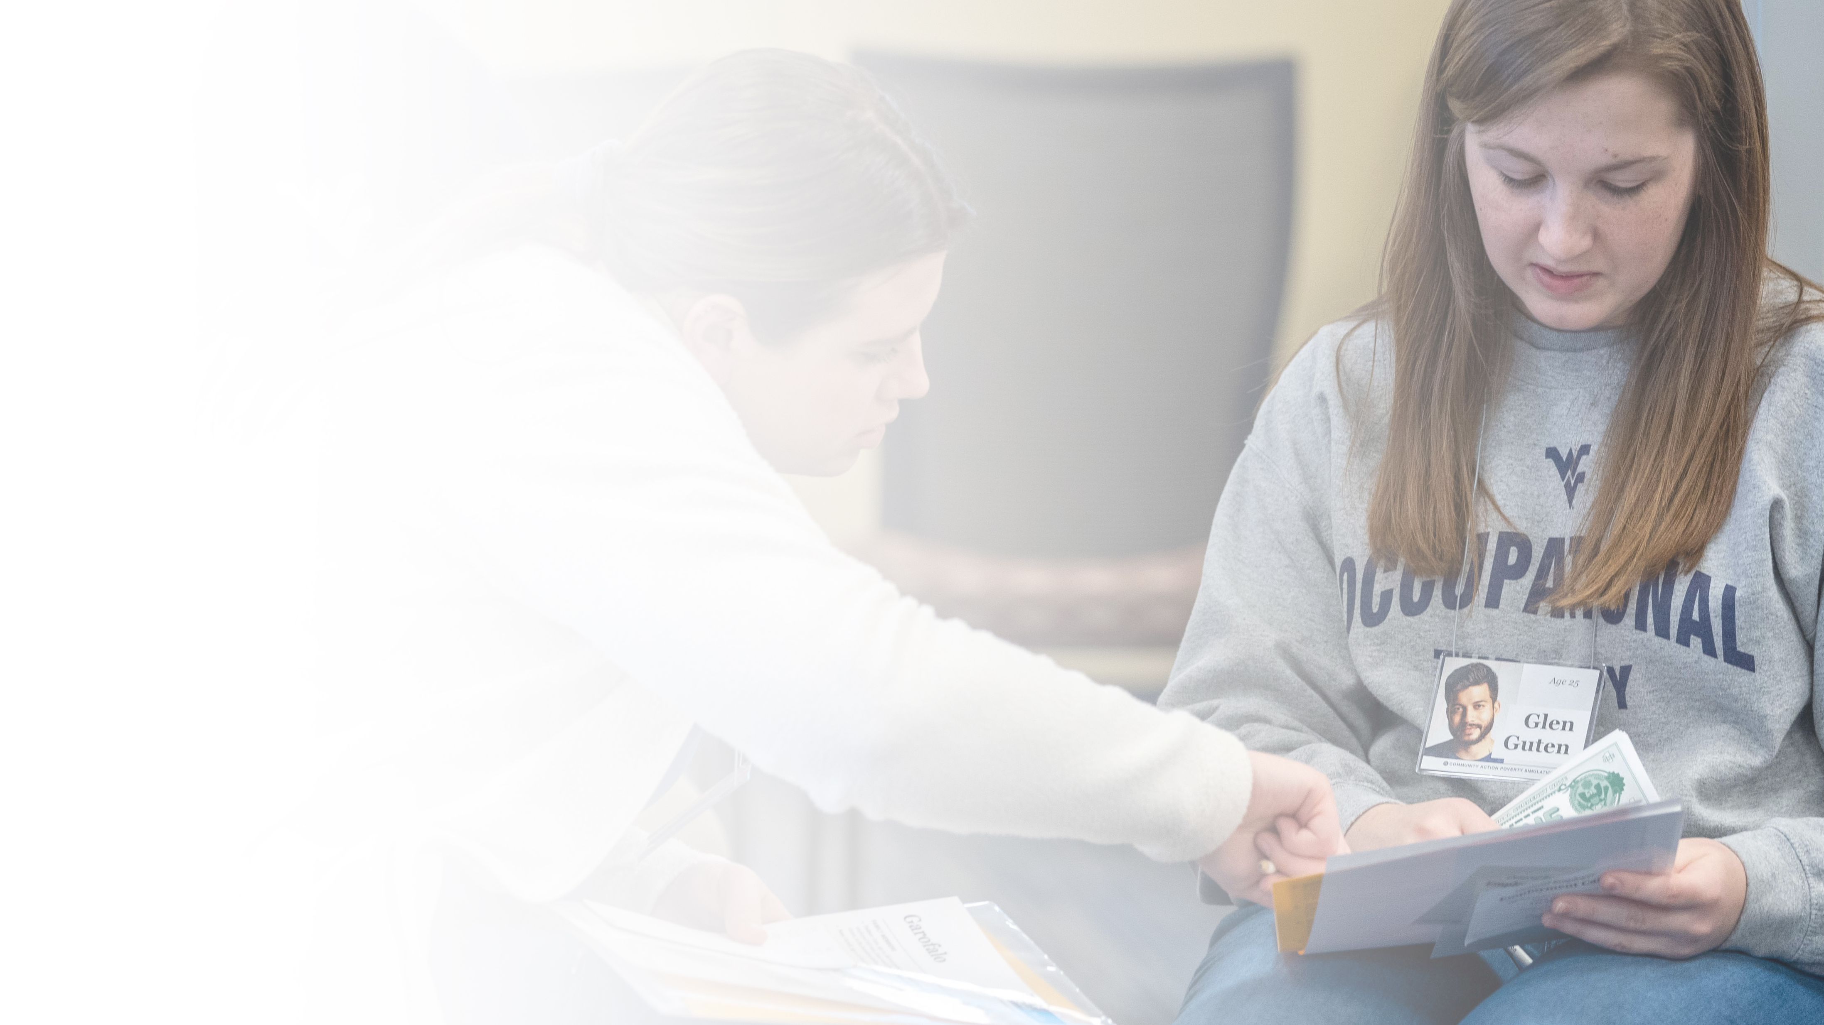
INTERPROFESSIONAL EDUCATION.
Provides students with unique opportunities to engage in immersive, skill-based learning with others outside their discipline to prepare them to work as a COLLABORATIVE PRACTICE TEAM.
593
Competency Session learners
324
Community Action Poverty Simulation learners
250
Project Delivery of Chronic Care (DOCC) learners
173
Interdisciplinary Education Apartment Simulation (IDEAS) learners
157
Rounding learners
10
Transitions of Care learners
*Fall 2022
Notes:
Data Source: Spring 2023 newsletter

