Slide 1
Rodent Isoflurane anesthesia
Created by: Samantha Glaspell, RVT
WVU Office of Laboratory Animals

Slide 2

Line up of contents
What is Anesthesia?
How does an Anesthetic machine work?
Parts of Machine
Special Considerations
Stages of Anesthesia
Induction Phase
Maintenance Phase
Group Anesthetizing
Monitoring
Recovery
Analgesia

Slide 3
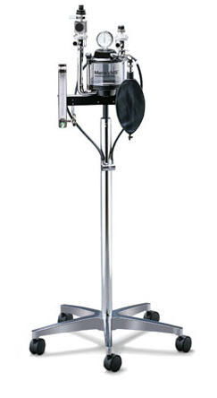
Anesthesia
Anesthesia- Loss of sensation with or without loss of consciousness
Anesthesia is delivered via an anesthetic machine with or without injectable sedatives.
Anesthetic Machine:

Slide 4
Anesthetic Machine
How does it work?
Oxygen Flowmeter (Liter/min)
Flowmeter Isoflurane Vaporizer (% of gas)
Vaporizer Common Outlet
Outlet Induction Chamber
Chamber Nose cone Adapter
Nose cone Patient
Exhaled CO2 Activated Charcoal
Reference: Principles of the Anesthetic Machine-MIP Company

Slide 5
Parts of the machine
Flowmeter
Uses an adjustable needle valve to deliver the desired flow of O2 in ml or liters per minute to the patient.
Read from the middle of metal indicator ball

Slide 6
Parts of the machine
Isoflurane Vaporizer
- produces an accurate gaseous concentration from a volatile liquid anesthetic. The dial or knob on the vaporizer can be adjusted so that the precise percentage of anesthetic gas leaving the vaporizer is known.

Slide 7
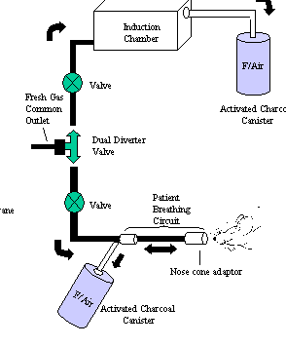
Parts of the machine
Patient Breathing Circuit
The mixture of oxygen + isoflurane is now being delivered to the patient
Goals:
Deliver oxygen to the patient
Deliver anesthetic to the patient
Remove carbon dioxide that is produced by the patient
Provide a method for assisting or controlling ventilation, if needed
- Rodents use the non-rebreathing system to reduce inhalation of CO2 due to their smaller size

Slide 8
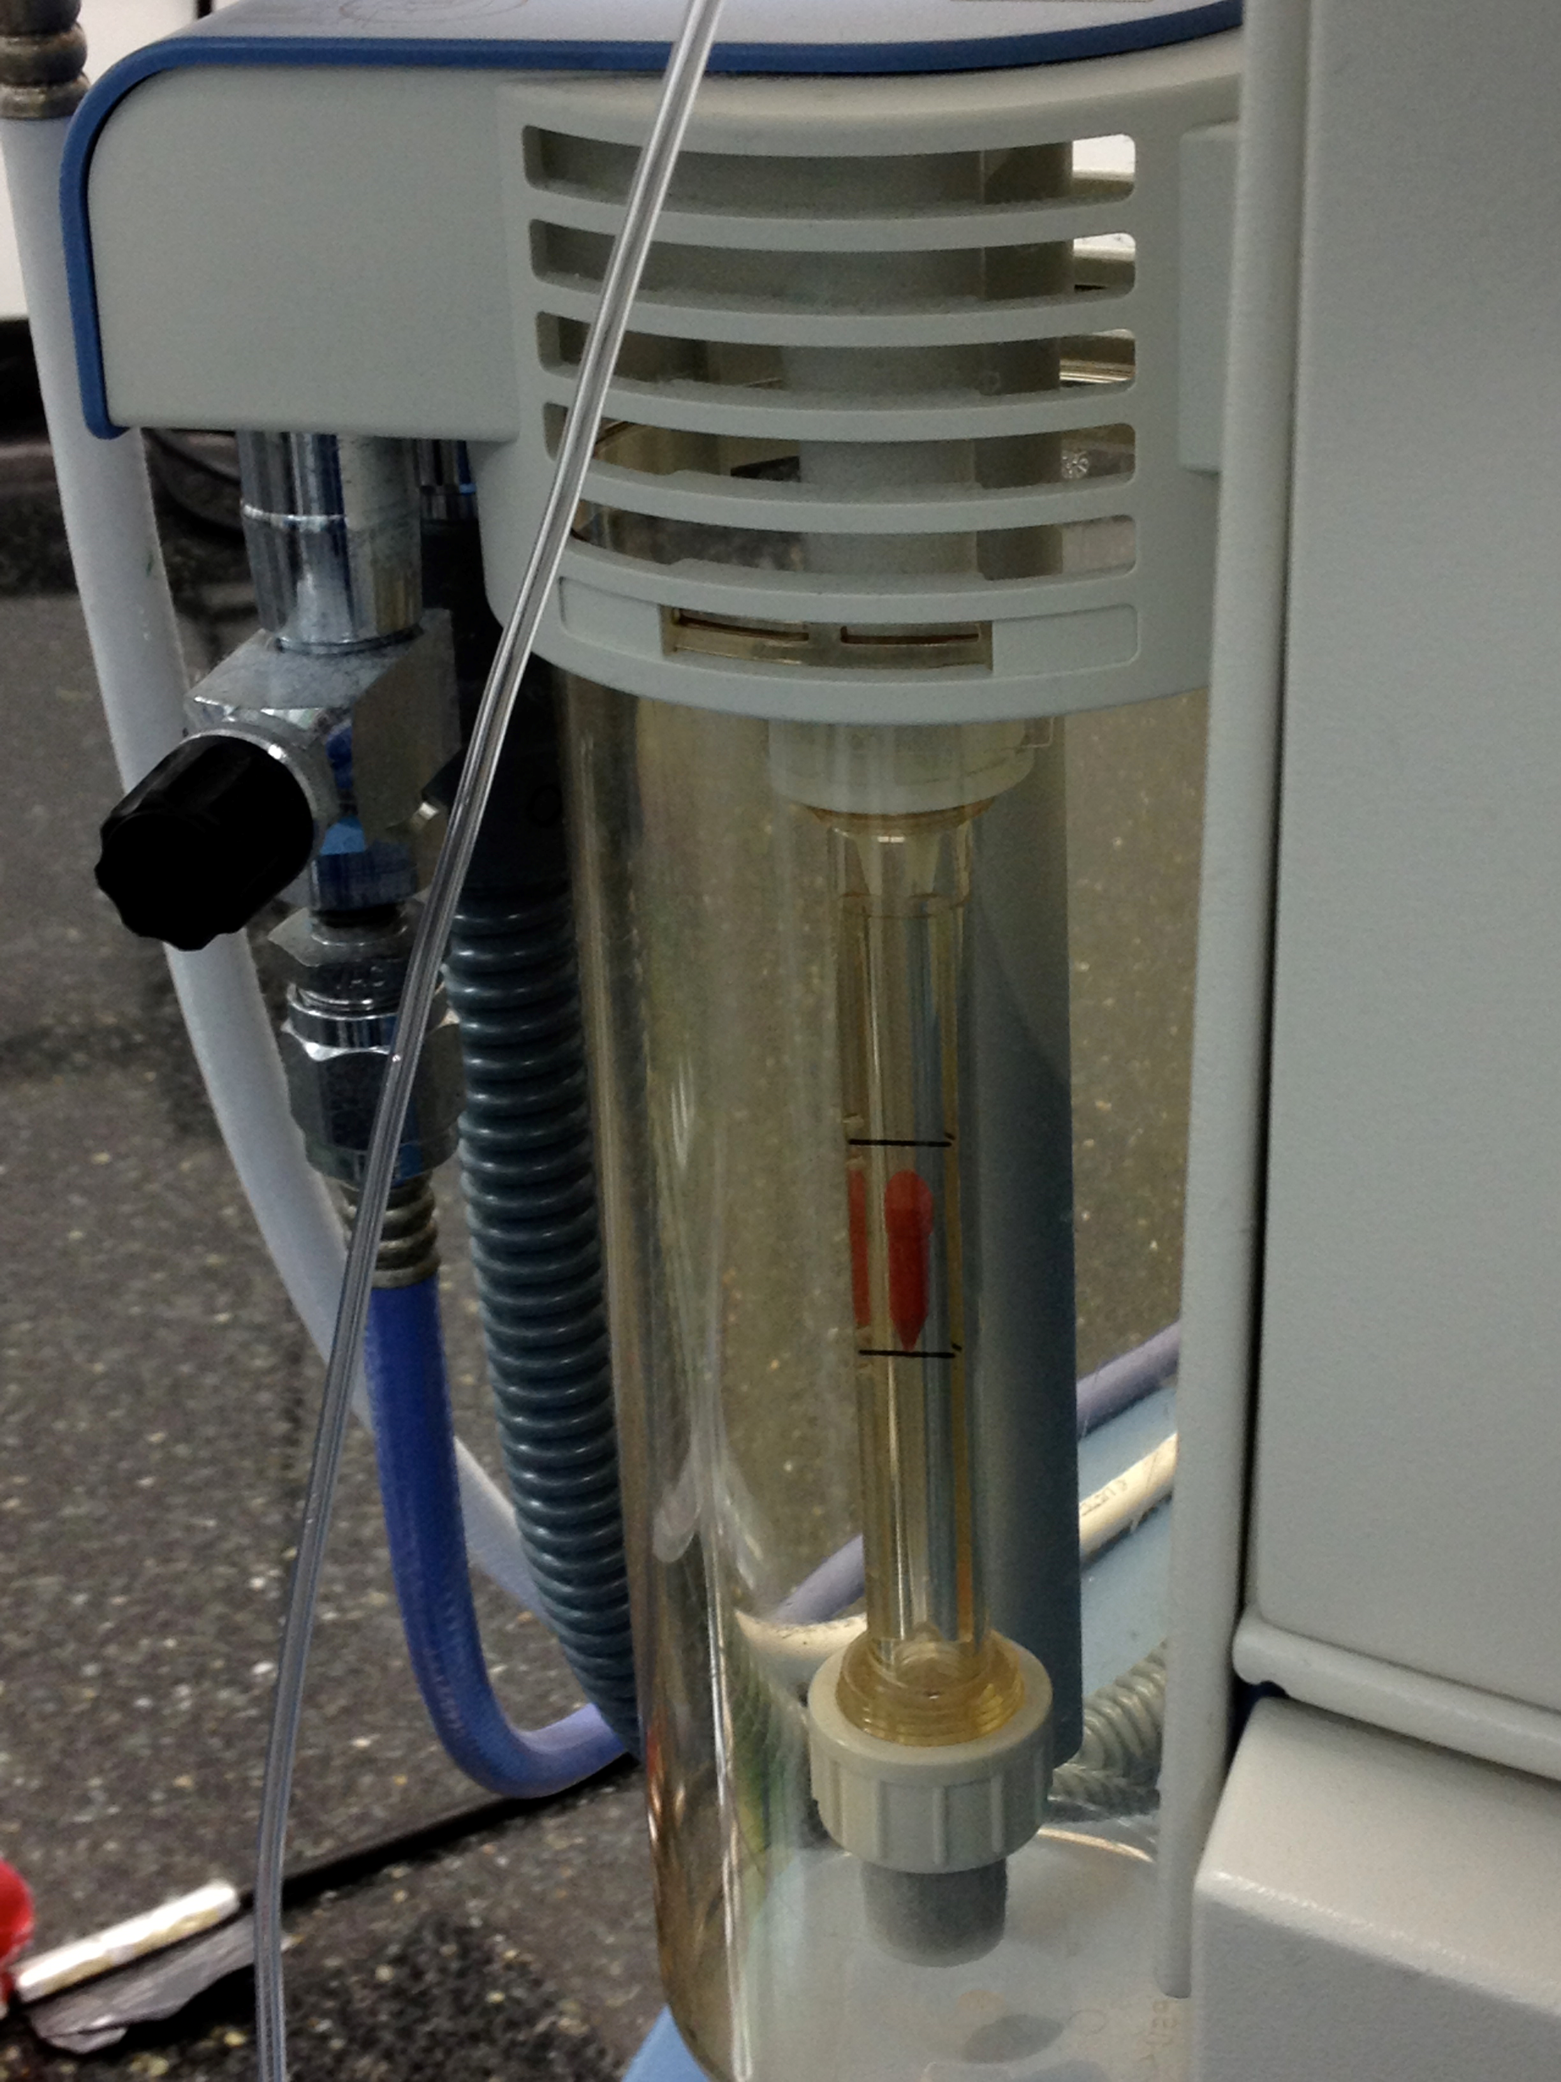
Parts of the machine
Scavenging System
-Used to absorb or eliminate waste anesthetic gases
F/Air Canisters- Activated Charcoal
Do not cover bottom
2. Vacuum System-

Slide 9
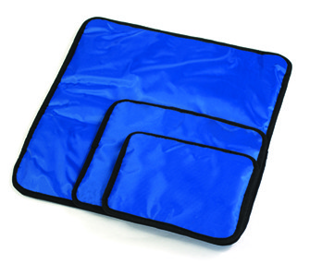
SPECIAL CONSIDERATIONS
Fasting is NOT usually necessary in mice
Water should never be restricted during the pre-anesthetic period.
Apply ophthalmic eye lubrication after the induction phase
Thermal support is critical to their survival and successful anesthetic recovery.
Re-circulating warm water blankets, Safe and Warm®, Snuggle Safe®, etc- RECOMMENDED
Electric heating pads and heat lamps- DISCOURAGED
Regardless of the source, the animal should never be placed directly in contact with the heat source, but should be separated from it by a towel or sterile drape.
Reference: WVU IACUC POLICY: Anesthesia and Analgesia in Mice

Slide 10
Stages of Anesthesia
Stage 1 — excitatory, disorientation, vocalization, urination, defecation.
Stage 2 — loss of consciousness with or without struggling and whining, many reflexes are intact but righting reflex is lost, rapid irregular breathing and rigidity.
Stage 3 — surgical stage of anesthesia, with loss of reflexes, muscle relaxation, deep and rhythmic breathing, planes 1-4 (light to deep).
Stage 4 — medullary paralysis with respiratory arrest, hypotension and imminent death. Cardio-pulmonary resuscitation and drugs to reverse anesthesia must be given or animal will die.
Reference: John Hopkins University- Survival Surgery Procedures: Rodents

Slide 11
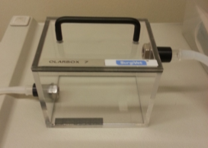
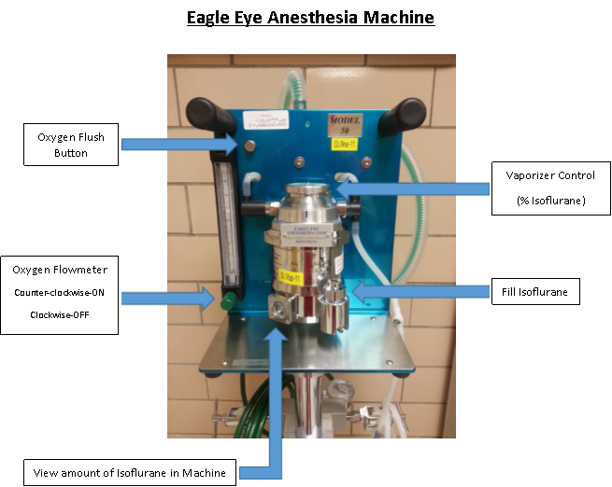
Anesthetizing
Induction Phase
Mouse Chamber
Turn oxygen source on
Verify O2 is sufficient for planned procedures
Turn flowmeter to 1-2 L/min
Place rodent into induction chamber
Verify nose cone valve is shut off
Turn isoflurane vaporizer to 4-5%
Verify isoflurane level is sufficient for planned procedures
Monitor animal until recumbent
Turn off isoflurane vaporizer
Push the oxygen flush valve (2) times
Remove rodent from induction chamber

Slide 12
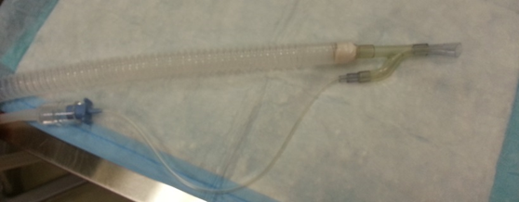
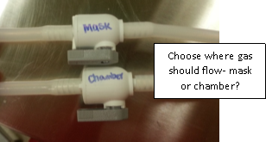
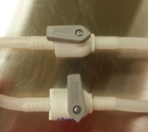
Anesthetizing
Mouse Mask
Maintenance Phase
Move the rodent to the nose cone apparatus
Turn off valve for the induction chamber
Turn on the valve for the nose cone
Move O2 from 1-2 L/min 0.1-0.5ml/min
Move dial on isoflurane from 4-5 % 1-0.5 %
Monitor analgesia depth through procedure.
Procedure complete, turn isoflurane off.
Keep O2 on until rodent wakes up
Turn O2 flowmeter to 0. Disconnect/ Turn O2 off
Push the oxygen flush valve until the pressure gauge reaches 0
ON

Slide 13
Anesthetizing Group of Rodents
Using the dual diverter valves, ensure both are open.
Anesthetic flow is now to the chamber and nose cone simultaneously
DOUBLE O2 FLOW RATE to deliver the appropriate amount to both locations

Slide 14
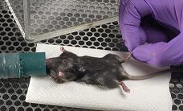
Monitoring
1. Anesthetic depth:
A. Inability to remain upright
B. Loss of purposeful voluntary movement
C. Loss of blink reflex
D. Muscle relaxation
E. Loss of response to reflex stimulation (toe or tail pinch with firm pressure
2. Respiratory rate and pattern: assessed by observing chest wall and abdominal movements (normal respiratory rate for an awake mouse at rest is 180/min, a slow rate drop of 50% is acceptable during anesthesia with a regular even pattern)
3. Mucus membrane color: mucous membranes should be pink (not grey, blue, or white)
Reference: WVU IACUC POLICY: Anesthesia and Analgesia in Mice

Slide 15
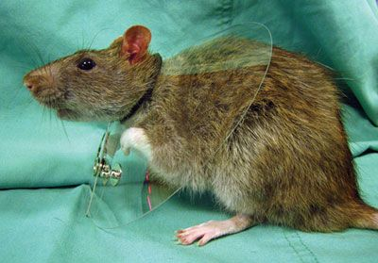
Recovery
Animals may not be returned to animal housing rooms following an anesthetized procedure until they are alert and full ambulatory.
Clean cage with only a clean paper towel or no bedding
Housed separately
Moist Chow to encourage eating
Provide heat support- placing a warm water re-circulating blanket and drape between mouse and the table
Or administer warmed normal saline or lactated Ringer’s solution (SQ or IP) during or after the surgery (not to exceed 5-20 ml/kg/hr)
Reference: WVU IACUC POLICY: Anesthesia and Analgesia in Mice

Slide 16
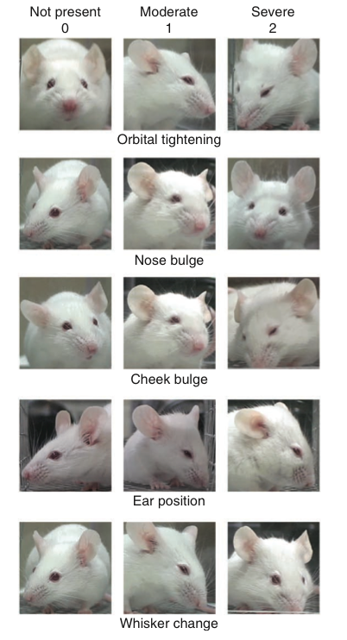
Analgesia
BEHAVIORAL:
Decreased grooming
Aggression
Self-mutilation
Reluctance to move
Abnormal posturing
Social isolation
Decreased appetite
Vocalization
PHYSIOLOGICAL:
Elevated blood pressure
Elevated heart rate
Elevated respiratory rate
Changes in body temperature
Pupil dilation
Reference: WVU IACUC POLICY: Anesthesia and Analgesia in Mice
Mouse Grimace Scale

Slide 17

Questions?

Slide 18
THANK YOU!!
Please contact the veterinary staff at (304) 293-3737 OLARvetstaff@hsc.wvu.edu
for any concerns or future training requests!

